Slide 1
GRADE 7 ACCELERATED · UNIT 6
Relationships in Triangles
Eight lessons in teaching order · the next slide jumps to each one
Grade 7 Accelerated · Unit 6 — Relationships in Triangles
1

Slide 2
Contents
6.01–02
Triangle Inequality Theorem; Converse of the Pythagorean Theorem
slide 3
6.03
Pythagorean Theorem
slide 38
6.04
Pythagorean Theorem in Real-World Problems
slide 73
6.05
Distance on the Coordinate Plane
slide 108
6.06
Real-World Coordinate-Plane Problems; Perimeter
slide 143
6.07–08
Similar Triangles; Indirect Measurement
slide 178
T-B1
Angle Pairs: Supplementary, Complementary, Vertical, Adjacent
slide 213
T-B2
Interior and Exterior Angles of a Triangle
slide 248
Grade 7 Accelerated · Unit 6 — Relationships in Triangles
2

Slide 3
← Contents
GRADE 7 ACCELERATED · UNIT 6 · LESSONS 1–2
Triangle Inequality Theorem; Converse of the Pythagorean Theorem
MA.8.GR.1.3
I can decide whether three lengths can make a triangle, and whether they make a right triangle.
Grade 7 Accelerated · Unit 6 · Lessons 1–2 — Triangle Inequality Theorem; Converse of the Pythagorean Theorem
1

Slide 4




Warm-Up
1. A car gets 32 miles per gallon. How far does it go on 9 gallons?
2. A figure of area
is scaled by
. The copy's area?
3. Find the value:
4. Find the value:
Grade 7 Accelerated · Unit 6 · Lessons 1–2 — Triangle Inequality Theorem; Converse of the Pythagorean Theorem
2

Slide 5
Warm-Up
1. A car gets 32 miles per gallon. How far does it go on 9 gallons?
288 mi
2. A figure of area
is scaled by
. The copy's area?
45 cm²
3. Find the value:
10
4. Find the value:
100
Grade 7 Accelerated · Unit 6 · Lessons 1–2 — Triangle Inequality Theorem; Converse of the Pythagorean Theorem
3

Slide 6

Vocabulary
triangle inequality
any two sides of a triangle add up to MORE than the third side
legs
the two sides of a right triangle that make the right angle
hypotenuse
the side across from the right angle — always the longest side
converse
a statement turned around: if
for the two shorter sides and the
longest, the triangle is right
Grade 7 Accelerated · Unit 6 · Lessons 1–2 — Triangle Inequality Theorem; Converse of the Pythagorean Theorem
4

Slide 7
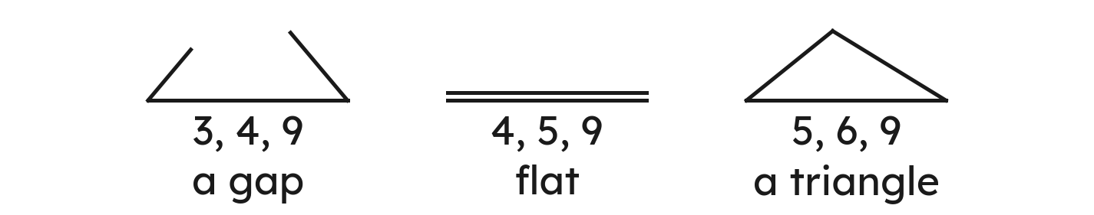



Notes
I. Two sides together must be longer than the third
Add the two shorter sides. A triangle needs MORE than the longest side.
On the FAST sheet:
,
,
Grade 7 Accelerated · Unit 6 · Lessons 1–2 — Triangle Inequality Theorem; Converse of the Pythagorean Theorem
5

Slide 8


Notes
II. The third side is between the difference and the sum
Sides 4 and 9: the third side x is more than 5 and less than 13.
Never
: at 5 or 13 the sides lie flat.
Grade 7 Accelerated · Unit 6 · Lessons 1–2 — Triangle Inequality Theorem; Converse of the Pythagorean Theorem
6

Slide 9
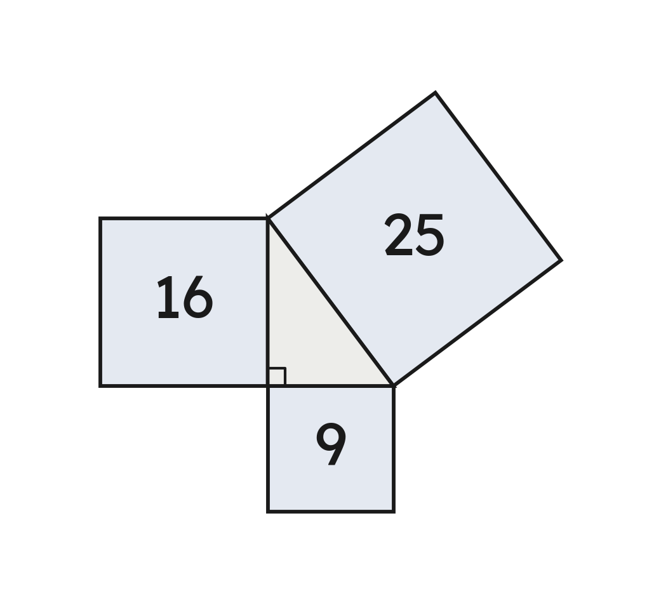





Notes
III. The Pythagorean Theorem, and its converse
Two shorter sides squared and added = the longest side squared: a right triangle.
:
, right.
:
, not
.
Grade 7 Accelerated · Unit 6 · Lessons 1–2 — Triangle Inequality Theorem; Converse of the Pythagorean Theorem
7

Slide 10
Example 1
Can sides of 5 cm, 8 cm and 14 cm make a triangle?
Grade 7 Accelerated · Unit 6 · Lessons 1–2 — Triangle Inequality Theorem; Converse of the Pythagorean Theorem
8

Slide 11


Example 1
Answer: No — 5 + 8 = 13 is less than 14.
Grade 7 Accelerated · Unit 6 · Lessons 1–2 — Triangle Inequality Theorem; Converse of the Pythagorean Theorem
9

Slide 12
Your Turn
Can sides of 7 inches, 9 inches and 15 inches make a triangle?
Grade 7 Accelerated · Unit 6 · Lessons 1–2 — Triangle Inequality Theorem; Converse of the Pythagorean Theorem
10

Slide 13

Your Turn
Can sides of 7 inches, 9 inches and 15 inches make a triangle?
16 is more than 15: a triangle.
Answer: Yes — 7 + 9 = 16 is more than 15.
Grade 7 Accelerated · Unit 6 · Lessons 1–2 — Triangle Inequality Theorem; Converse of the Pythagorean Theorem
11

Slide 14
Example 2
A triangle has sides of 20 m, 12 m and 16 m.
Is it a right triangle?
Grade 7 Accelerated · Unit 6 · Lessons 1–2 — Triangle Inequality Theorem; Converse of the Pythagorean Theorem
12

Slide 15
Example 2
Answer: Yes — 12² + 16² = 20².
Grade 7 Accelerated · Unit 6 · Lessons 1–2 — Triangle Inequality Theorem; Converse of the Pythagorean Theorem
13

Slide 16
Your Turn
A triangle has sides of 8 ft, 11 ft and 14 ft.
Is it a right triangle?
Grade 7 Accelerated · Unit 6 · Lessons 1–2 — Triangle Inequality Theorem; Converse of the Pythagorean Theorem
14

Slide 17

Your Turn
A triangle has sides of 8 ft, 11 ft and 14 ft.
Is it a right triangle?
: not equal.
Answer: No — 185 is not 196.
Grade 7 Accelerated · Unit 6 · Lessons 1–2 — Triangle Inequality Theorem; Converse of the Pythagorean Theorem
15

Slide 18
Whiteboards · Question 1 of 9
Can sides of 2 ft, 7 ft and 10 ft make a triangle?
Answer it.
Grade 7 Accelerated · Unit 6 · Lessons 1–2 — Triangle Inequality Theorem; Converse of the Pythagorean Theorem
16

Slide 19

Whiteboards · Question 1 of 9
Can sides of 2 ft, 7 ft and 10 ft make a triangle?
9 is less than 10: no triangle.
Answer: No — 2 + 7 = 9 is less than 10.
Grade 7 Accelerated · Unit 6 · Lessons 1–2 — Triangle Inequality Theorem; Converse of the Pythagorean Theorem
17

Slide 20
Whiteboards · Question 2 of 9
Can sides of 6 m, 6 m and 11 m make a triangle?
Answer it.
Grade 7 Accelerated · Unit 6 · Lessons 1–2 — Triangle Inequality Theorem; Converse of the Pythagorean Theorem
18

Slide 21

Whiteboards · Question 2 of 9
Can sides of 6 m, 6 m and 11 m make a triangle?
12 is more than 11: a triangle.
Answer: Yes — 6 + 6 = 12 is more than 11.
Grade 7 Accelerated · Unit 6 · Lessons 1–2 — Triangle Inequality Theorem; Converse of the Pythagorean Theorem
19

Slide 22
Whiteboards · Question 3 of 9
Which three lengths can make a triangle?
A. 7, 7, 14
B. 5, 11, 8
C. 3, 10, 6
D. 4, 6, 12
Answer it.
Grade 7 Accelerated · Unit 6 · Lessons 1–2 — Triangle Inequality Theorem; Converse of the Pythagorean Theorem
20

Slide 23
Whiteboards · Question 3 of 9
Which three lengths can make a triangle?
, more than 11: a triangle.
In each other set the two shorter sides fall short or lie flat.
Answer: B — 5, 11, 8
Grade 7 Accelerated · Unit 6 · Lessons 1–2 — Triangle Inequality Theorem; Converse of the Pythagorean Theorem
21

Slide 24
Whiteboards · Question 4 of 9
Two sides of a triangle are 7 cm and 12 cm.
Write an inequality for the length x, in centimeters, of the third side.
Answer it.
Grade 7 Accelerated · Unit 6 · Lessons 1–2 — Triangle Inequality Theorem; Converse of the Pythagorean Theorem
22

Slide 25



Whiteboards · Question 4 of 9
Two sides of a triangle are 7 cm and 12 cm.
Write an inequality for the length x, in centimeters, of the third side.
and
Answer: 5 < x < 19 — more than 5 cm and less than 19 cm.
Grade 7 Accelerated · Unit 6 · Lessons 1–2 — Triangle Inequality Theorem; Converse of the Pythagorean Theorem
23

Slide 26




Whiteboards · Question 5 of 9
Two sides of a triangle are 6 cm and 10 cm.
Which inequality shows every possible length x, in centimeters, of the third side?
A.
B.
C.
D.
Answer it.
Grade 7 Accelerated · Unit 6 · Lessons 1–2 — Triangle Inequality Theorem; Converse of the Pythagorean Theorem
24

Slide 27



Whiteboards · Question 5 of 9
Two sides of a triangle are 6 cm and 10 cm.
Which inequality shows every possible length x, in centimeters, of the third side?
and
— never equal
Answer: C — 4 < x < 16
Grade 7 Accelerated · Unit 6 · Lessons 1–2 — Triangle Inequality Theorem; Converse of the Pythagorean Theorem
25

Slide 28
Whiteboards · Question 6 of 9
Do sides of 8 inches, 15 inches and 17 inches make a right triangle?
Answer it.
Grade 7 Accelerated · Unit 6 · Lessons 1–2 — Triangle Inequality Theorem; Converse of the Pythagorean Theorem
26

Slide 29

Whiteboards · Question 6 of 9
Do sides of 8 inches, 15 inches and 17 inches make a right triangle?
: equal — a right triangle.
Answer: Yes — 8² + 15² = 289 = 17².
Grade 7 Accelerated · Unit 6 · Lessons 1–2 — Triangle Inequality Theorem; Converse of the Pythagorean Theorem
27

Slide 30
Whiteboards · Question 7 of 9
A triangle has sides of 25 cm, 7 cm and 24 cm.
Is it a right triangle? Which answer has the right reason?
A. Yes, because 7² + 24² = 25²
B. Yes, because 7 + 24 > 25
C. No, because 25² + 7² ≠ 24²
D. No, because 7 + 24 ≠ 25
Answer it.
Grade 7 Accelerated · Unit 6 · Lessons 1–2 — Triangle Inequality Theorem; Converse of the Pythagorean Theorem
28

Slide 31

Whiteboards · Question 7 of 9
A triangle has sides of 25 cm, 7 cm and 24 cm.
Is it a right triangle? Which answer has the right reason?
: equal — right.
Answer: A — yes, because 7² + 24² = 25²
Grade 7 Accelerated · Unit 6 · Lessons 1–2 — Triangle Inequality Theorem; Converse of the Pythagorean Theorem
29

Slide 32
Whiteboards · Question 8 of 9
A triangular sail has sides of 20 ft, 21 ft and 29 ft, and it weighs 12 pounds.
Does the sail have a right angle?
Answer it.
Grade 7 Accelerated · Unit 6 · Lessons 1–2 — Triangle Inequality Theorem; Converse of the Pythagorean Theorem
30

Slide 33

Whiteboards · Question 8 of 9
A triangular sail has sides of 20 ft, 21 ft and 29 ft, and it weighs 12 pounds.
Does the sail have a right angle?
: a right angle.
Answer: Yes — 20² + 21² = 841 = 29².
Grade 7 Accelerated · Unit 6 · Lessons 1–2 — Triangle Inequality Theorem; Converse of the Pythagorean Theorem
31

Slide 34
Whiteboards · Question 9 of 9
Ana says sides of 6, 7 and 9 make a right triangle because 6 + 7 > 9.
Is she right? Explain.
Write your answer in sentences.
Grade 7 Accelerated · Unit 6 · Lessons 1–2 — Triangle Inequality Theorem; Converse of the Pythagorean Theorem
32

Slide 35


Whiteboards · Question 9 of 9
Ana says sides of 6, 7 and 9 make a right triangle because 6 + 7 > 9.
Is she right? Explain.
, but
.
Answer: No — 6 + 7 > 9 shows only a triangle; 85 is not 81, so it is not right.
Grade 7 Accelerated · Unit 6 · Lessons 1–2 — Triangle Inequality Theorem; Converse of the Pythagorean Theorem
33

Slide 36
Independent Set
1.
Can sides of 4 cm, 8 cm and 13 cm make a triangle?
2.
Can sides of 9 inches, 9 inches and 18 inches make a triangle?
3.
Two sides of a triangle are 5 m and 11 m. Write an inequality for the length x, in meters, of the third side.
4.
Do sides of 28 cm, 45 cm and 53 cm make a right triangle?
5.
Do sides of 17 ft, 10 ft and 14 ft make a right triangle?
6.
A carpenter joins boards of 30 inches, 40 inches and 50 inches into a triangle. Is one corner a right angle?
Grade 7 Accelerated · Unit 6 · Lessons 1–2 — Triangle Inequality Theorem; Converse of the Pythagorean Theorem
34

Slide 37
IXL
1.
Open IXL and start today's skills.
2.
Work on paper where the question needs work. The answer box does not show it.
3.
Every skill listed is required, to a SmartScore of 67. Due by the Unit 6 test.
Today's skills — all required
Triangle inequality — 2N5
Converse of the Pythagorean theorem: is it a right triangle? — EQZ
Grade 7 Accelerated · Unit 6 · Lessons 1–2 — Triangle Inequality Theorem; Converse of the Pythagorean Theorem
35

Slide 38
← Contents
GRADE 7 ACCELERATED · UNIT 6 · LESSON 3
Pythagorean Theorem
MA.8.GR.1.1
I can find a missing side of a right triangle — the hypotenuse, or a leg.
Grade 7 Accelerated · Unit 6 · Lesson 3 — Pythagorean Theorem
1

Slide 39


Warm-Up
1. Can sides of 4 inches, 7 inches and 12 inches make a triangle?
2. A printer prints 18 pages a minute. Pages in 4.5 minutes?
3. Find the value:
4. Find the value:
Grade 7 Accelerated · Unit 6 · Lesson 3 — Pythagorean Theorem
2

Slide 40
Warm-Up
1. Can sides of 4 inches, 7 inches and 12 inches make a triangle?
No — 4 + 7 = 11 < 12
2. A printer prints 18 pages a minute. Pages in 4.5 minutes?
81 pages
3. Find the value:
14
4. Find the value:
64
Grade 7 Accelerated · Unit 6 · Lesson 3 — Pythagorean Theorem
3

Slide 41
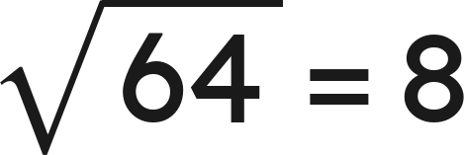
Vocabulary
Pythagorean Theorem
in every right triangle, leg² + leg² = hypotenuse²:
hypotenuse
c — the side across from the right angle, always the longest side
square root
the number that, times itself,
makes the number under the root sign:
Grade 7 Accelerated · Unit 6 · Lesson 3 — Pythagorean Theorem
4

Slide 42
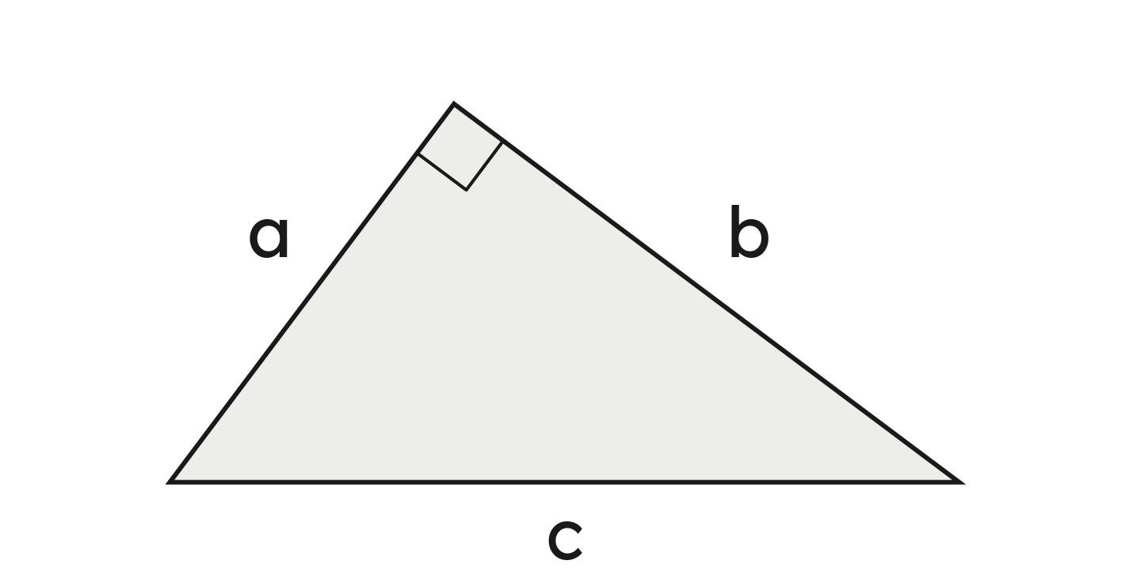

Notes
I. The square corner first; c is across from it
The legs' squares add up to the hypotenuse's square. c is across from the right angle — always the longest side.
Grade 7 Accelerated · Unit 6 · Lesson 3 — Pythagorean Theorem
5

Slide 43


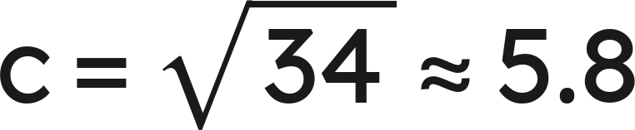
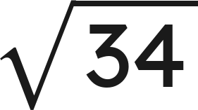
Notes
II. The hypotenuse: square, add, then the root
Legs 3 and 5:
,
Exact:
. To the nearest tenth: 5.8.
Grade 7 Accelerated · Unit 6 · Lesson 3 — Pythagorean Theorem
6

Slide 44


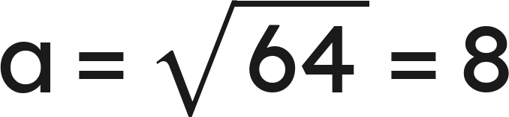

Notes
III. A leg: subtract the squares
For a leg, subtract:
.
Check: a leg is shorter than the hypotenuse.
Grade 7 Accelerated · Unit 6 · Lesson 3 — Pythagorean Theorem
7

Slide 45
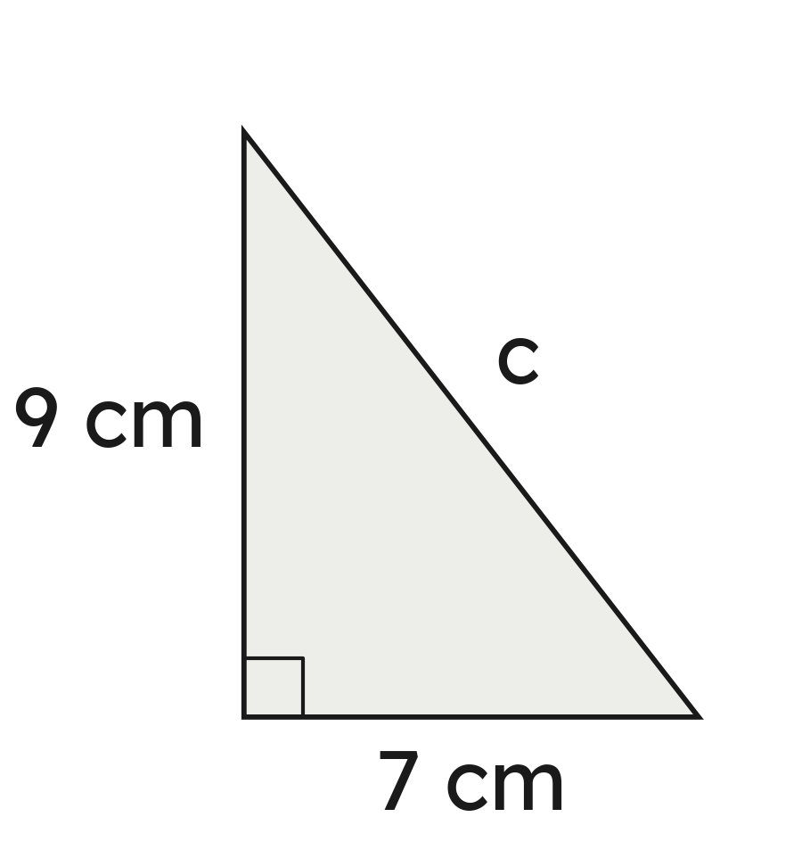
Example 1
A right triangle has legs of 7 cm and 9 cm.
How long is the hypotenuse? Give it exactly and to the nearest tenth.
Grade 7 Accelerated · Unit 6 · Lesson 3 — Pythagorean Theorem
8

Slide 46

Example 1
Answer: c = √130 cm ≈ 11.4 cm
Grade 7 Accelerated · Unit 6 · Lesson 3 — Pythagorean Theorem
9

Slide 47
Your Turn
A right triangle has legs of 5 inches and 11 inches.
How long is the hypotenuse, exactly and to the nearest tenth?
Grade 7 Accelerated · Unit 6 · Lesson 3 — Pythagorean Theorem
10

Slide 48

Your Turn
A right triangle has legs of 5 inches and 11 inches.
How long is the hypotenuse, exactly and to the nearest tenth?
Answer: c = √146 in ≈ 12.1 in
Grade 7 Accelerated · Unit 6 · Lesson 3 — Pythagorean Theorem
11

Slide 49
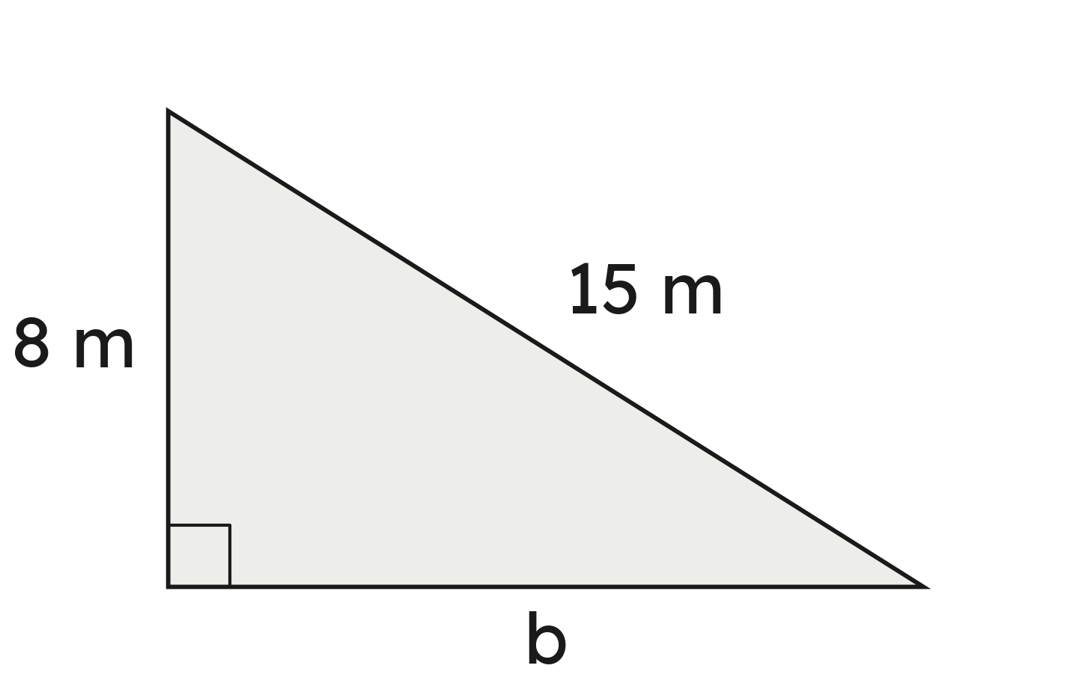
Example 2
A right triangle has a hypotenuse of 15 m and one leg of 8 m.
How long is the other leg? Give it exactly and to the nearest tenth.
Grade 7 Accelerated · Unit 6 · Lesson 3 — Pythagorean Theorem
12

Slide 50
Example 2
Answer: b = √161 m ≈ 12.7 m
Grade 7 Accelerated · Unit 6 · Lesson 3 — Pythagorean Theorem
13

Slide 51
Your Turn
A right triangle has a hypotenuse of 11 ft and one leg of 6 ft.
How long is the other leg, exactly and to the nearest tenth?
Grade 7 Accelerated · Unit 6 · Lesson 3 — Pythagorean Theorem
14

Slide 52

Your Turn
A right triangle has a hypotenuse of 11 ft and one leg of 6 ft.
How long is the other leg, exactly and to the nearest tenth?
Answer: b = √85 ft ≈ 9.2 ft
Grade 7 Accelerated · Unit 6 · Lesson 3 — Pythagorean Theorem
15

Slide 53
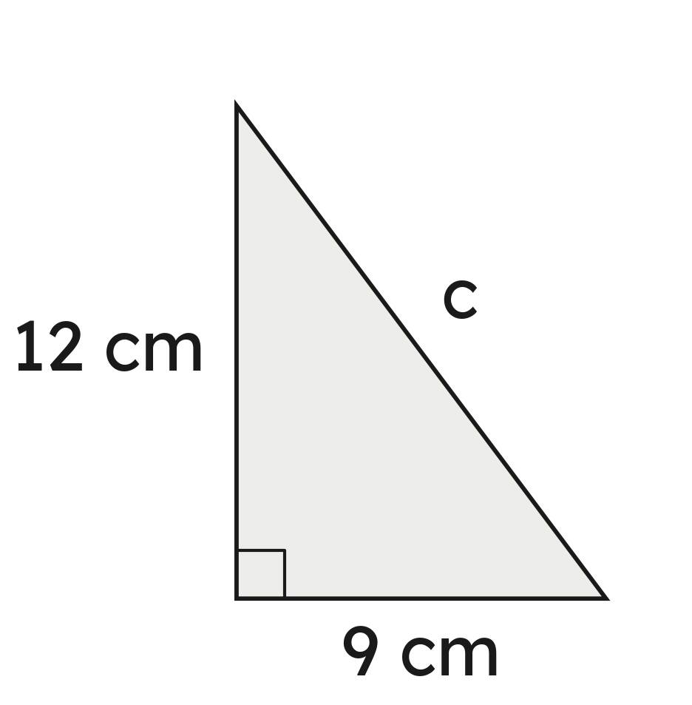
Whiteboards · Question 1 of 9
A right triangle has legs of 9 cm and 12 cm.
How long is the hypotenuse?
Answer it.
Grade 7 Accelerated · Unit 6 · Lesson 3 — Pythagorean Theorem
16

Slide 54

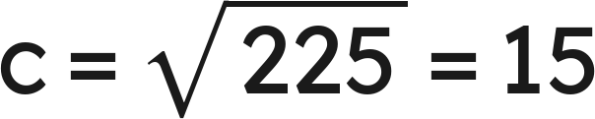
Whiteboards · Question 1 of 9
A right triangle has legs of 9 cm and 12 cm.
How long is the hypotenuse?
Answer: 15 cm
Grade 7 Accelerated · Unit 6 · Lesson 3 — Pythagorean Theorem
17

Slide 55
Whiteboards · Question 2 of 9
A right triangle has legs of 4 inches and 9 inches.
How long is the hypotenuse, to the nearest tenth?
Answer it.
Grade 7 Accelerated · Unit 6 · Lesson 3 — Pythagorean Theorem
18

Slide 56


Whiteboards · Question 2 of 9
A right triangle has legs of 4 inches and 9 inches.
How long is the hypotenuse, to the nearest tenth?
Answer: √97 in ≈ 9.8 in
Grade 7 Accelerated · Unit 6 · Lesson 3 — Pythagorean Theorem
19

Slide 57
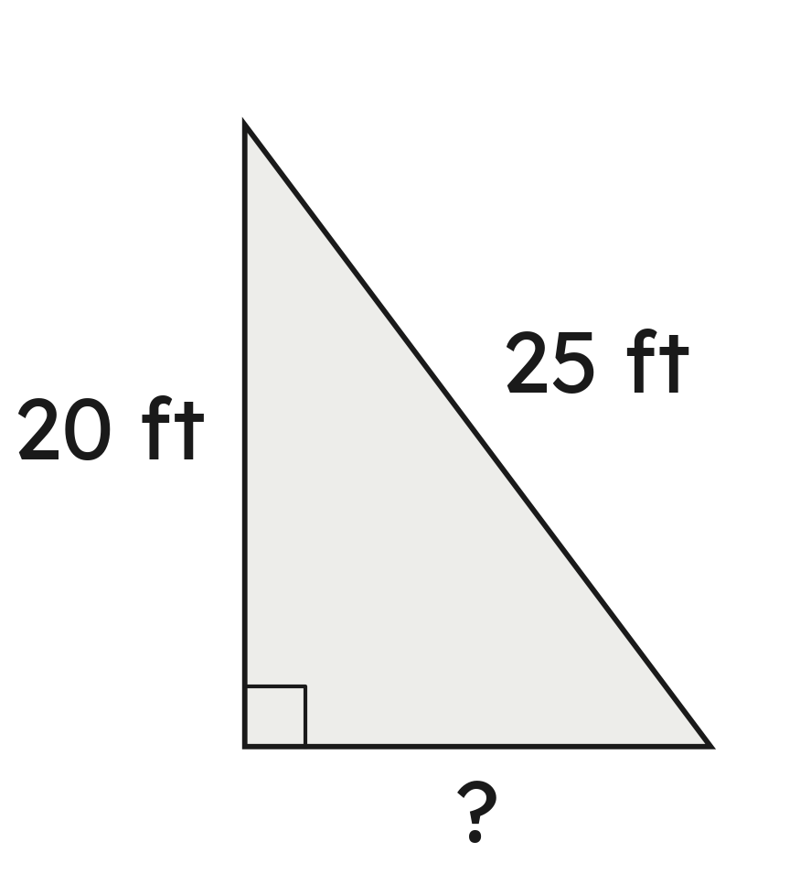
Whiteboards · Question 3 of 9
A right triangle has a hypotenuse of 25 ft and one leg of 20 ft.
How long is the other leg?
Answer it.
Grade 7 Accelerated · Unit 6 · Lesson 3 — Pythagorean Theorem
20

Slide 58
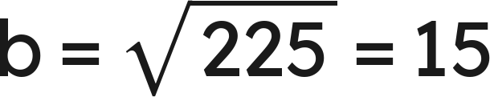
Whiteboards · Question 3 of 9
A right triangle has a hypotenuse of 25 ft and one leg of 20 ft.
How long is the other leg?
Answer: 15 ft
Grade 7 Accelerated · Unit 6 · Lesson 3 — Pythagorean Theorem
21

Slide 59
Whiteboards · Question 4 of 9
A right triangle has a hypotenuse of 41 m and one leg of 40 m.
How long is the other leg?
A. 9 m
B. 81 m
C. 1 m
D. 57.3 m
Answer it.
Grade 7 Accelerated · Unit 6 · Lesson 3 — Pythagorean Theorem
22

Slide 60

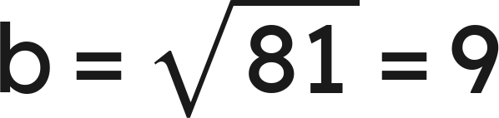
Whiteboards · Question 4 of 9
A right triangle has a hypotenuse of 41 m and one leg of 40 m.
How long is the other leg?
Answer: A — 9 m
Grade 7 Accelerated · Unit 6 · Lesson 3 — Pythagorean Theorem
23

Slide 61
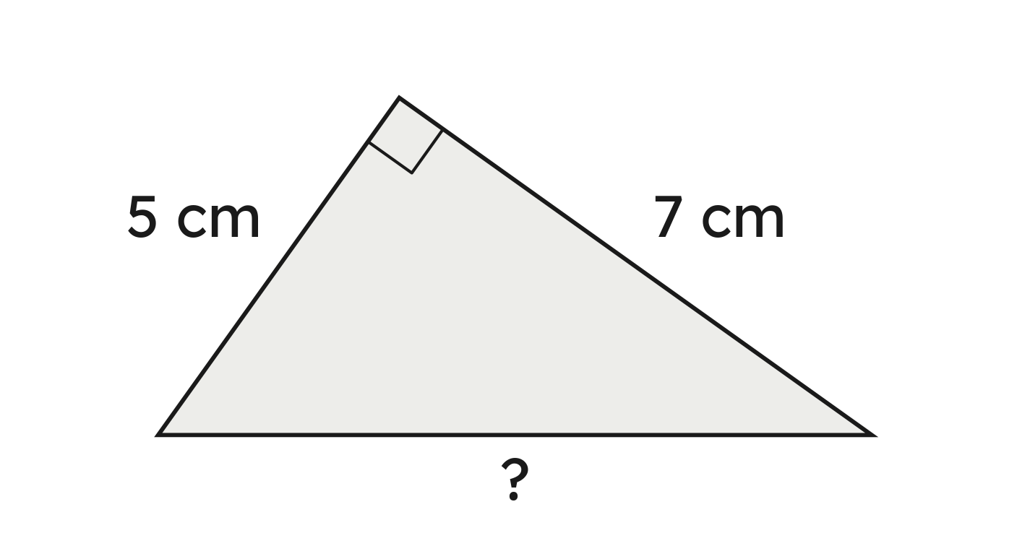
Whiteboards · Question 5 of 9
Two sides of this right triangle are 5 cm and 7 cm.
How long is the third side, to the nearest tenth?
Answer it.
Grade 7 Accelerated · Unit 6 · Lesson 3 — Pythagorean Theorem
24

Slide 62

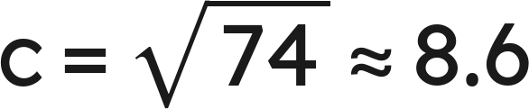
Whiteboards · Question 5 of 9
Two sides of this right triangle are 5 cm and 7 cm.
How long is the third side, to the nearest tenth?
Answer: √74 cm ≈ 8.6 cm
Grade 7 Accelerated · Unit 6 · Lesson 3 — Pythagorean Theorem
25

Slide 63




Whiteboards · Question 6 of 9
A right triangle's hypotenuse is 20 inches; its legs are 16 inches and x.
Which equation finds x?
A.
B.
C.
D.
Answer it.
Grade 7 Accelerated · Unit 6 · Lesson 3 — Pythagorean Theorem
26

Slide 64
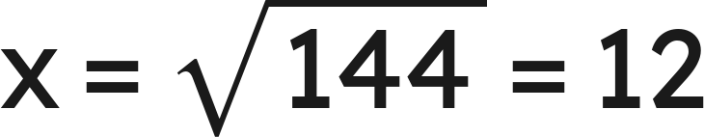
Whiteboards · Question 6 of 9
A right triangle's hypotenuse is 20 inches; its legs are 16 inches and x.
Which equation finds x?
Answer: D: 16² + x² = 20², so x = 12 in
Grade 7 Accelerated · Unit 6 · Lesson 3 — Pythagorean Theorem
27

Slide 65
Whiteboards · Question 7 of 9
A right triangle has a hypotenuse of 14 m and one leg of 9 m.
How long is the other leg, to the nearest tenth?
Answer it.
Grade 7 Accelerated · Unit 6 · Lesson 3 — Pythagorean Theorem
28

Slide 66


Whiteboards · Question 7 of 9
A right triangle has a hypotenuse of 14 m and one leg of 9 m.
How long is the other leg, to the nearest tenth?
Answer: √115 m ≈ 10.7 m
Grade 7 Accelerated · Unit 6 · Lesson 3 — Pythagorean Theorem
29

Slide 67
Whiteboards · Question 8 of 9
A pennant is cut as a right triangle with legs of 8 inches and 11 inches. The fabric costs 6 dollars.
How long is its longest side, to the nearest tenth?
Answer it.
Grade 7 Accelerated · Unit 6 · Lesson 3 — Pythagorean Theorem
30

Slide 68

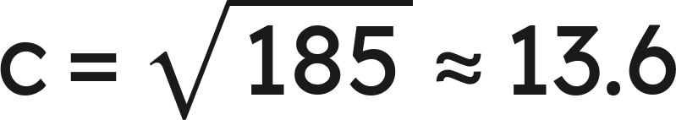
Whiteboards · Question 8 of 9
A pennant is cut as a right triangle with legs of 8 inches and 11 inches. The fabric costs 6 dollars.
How long is its longest side, to the nearest tenth?
Answer: √185 in ≈ 13.6 in
Grade 7 Accelerated · Unit 6 · Lesson 3 — Pythagorean Theorem
31

Slide 69
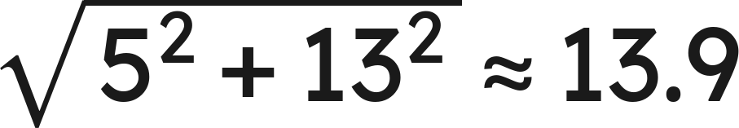
Whiteboards · Question 9 of 9
Jo finds a leg of a right triangle. The hypotenuse is 13 cm and the other leg is 5 cm.
She writes
.
What went wrong? How long is the leg?
Write your answer in sentences.
Grade 7 Accelerated · Unit 6 · Lesson 3 — Pythagorean Theorem
32

Slide 70
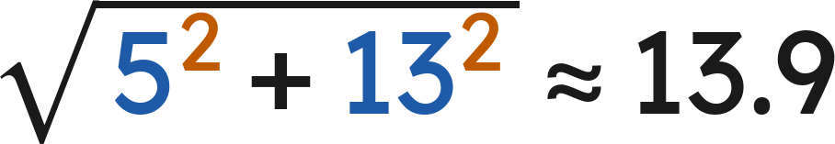

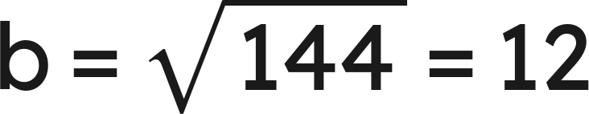
Whiteboards · Question 9 of 9
Jo finds a leg of a right triangle. The hypotenuse is 13 cm and the other leg is 5 cm.
She writes
.
What went wrong? How long is the leg?
Answer: She added the squares; a leg must be shorter than 13 cm. Subtract: the leg is 12 cm.
Grade 7 Accelerated · Unit 6 · Lesson 3 — Pythagorean Theorem
33

Slide 71
Independent Set
1.
A right triangle has legs of 12 m and 5 m. How long is the hypotenuse?
2.
A right triangle has legs of 3 ft and 8 ft. How long is the hypotenuse, exactly and to the nearest tenth?
3.
A right triangle has a hypotenuse of 39 cm and one leg of 36 cm. How long is the other leg?
4.
A right triangle has a hypotenuse of 11 inches and one leg of 4 inches. How long is the other leg, exactly and to the nearest tenth?
5.
The right triangle on your paper has legs of 6 m and 11 m. How long is its hypotenuse, to the nearest tenth?
6.
A right triangle has a hypotenuse of 25 yd and one leg of 24 yd. The other leg is x. Write the equation that finds x, then find x.
Grade 7 Accelerated · Unit 6 · Lesson 3 — Pythagorean Theorem
34

Slide 72
IXL
1.
Open IXL and start today's skills.
2.
Work on paper where the question needs work. The answer box does not show it.
3.
Every skill listed is required, to a SmartScore of 67. Due by the Unit 6 test.
Today's skills — all required
Pythagorean theorem: find the missing leg or hypotenuse length — MTM
Grade 7 Accelerated · Unit 6 · Lesson 3 — Pythagorean Theorem
35

Slide 73
← Contents
GRADE 7 ACCELERATED · UNIT 6 · LESSON 4
Pythagorean Theorem in Real-World Problems
MA.8.GR.1.1
I can find a length in a real situation by finding the right triangle inside it.
Grade 7 Accelerated · Unit 6 · Lesson 4 — Pythagorean Theorem in Real-World Problems
1

Slide 74
Warm-Up
1. A right triangle: hypotenuse 25 ft, one leg 24 ft. The other leg?
2. Do sides of 9, 40 and 41 make a right triangle?
3. A plan's scale is 1 in : 4 ft. A wall is 3.5 inches on it. Real length?
4. How many right angles does a rectangle have?
Grade 7 Accelerated · Unit 6 · Lesson 4 — Pythagorean Theorem in Real-World Problems
2

Slide 75
Warm-Up
1. A right triangle: hypotenuse 25 ft, one leg 24 ft. The other leg?
7 ft
2. Do sides of 9, 40 and 41 make a right triangle?
Yes — 81 + 1,600 = 1,681 = 41²
3. A plan's scale is 1 in : 4 ft. A wall is 3.5 inches on it. Real length?
14 ft
4. How many right angles does a rectangle have?
4
Grade 7 Accelerated · Unit 6 · Lesson 4 — Pythagorean Theorem in Real-World Problems
3

Slide 76
Vocabulary
diagonal
the segment from one corner of a rectangle to the opposite corner — the hypotenuse of the right triangle it cuts off
rise and run
a ramp's height and the distance along the ground it covers; the ramp itself is the hypotenuse
Grade 7 Accelerated · Unit 6 · Lesson 4 — Pythagorean Theorem in Real-World Problems
4

Slide 77
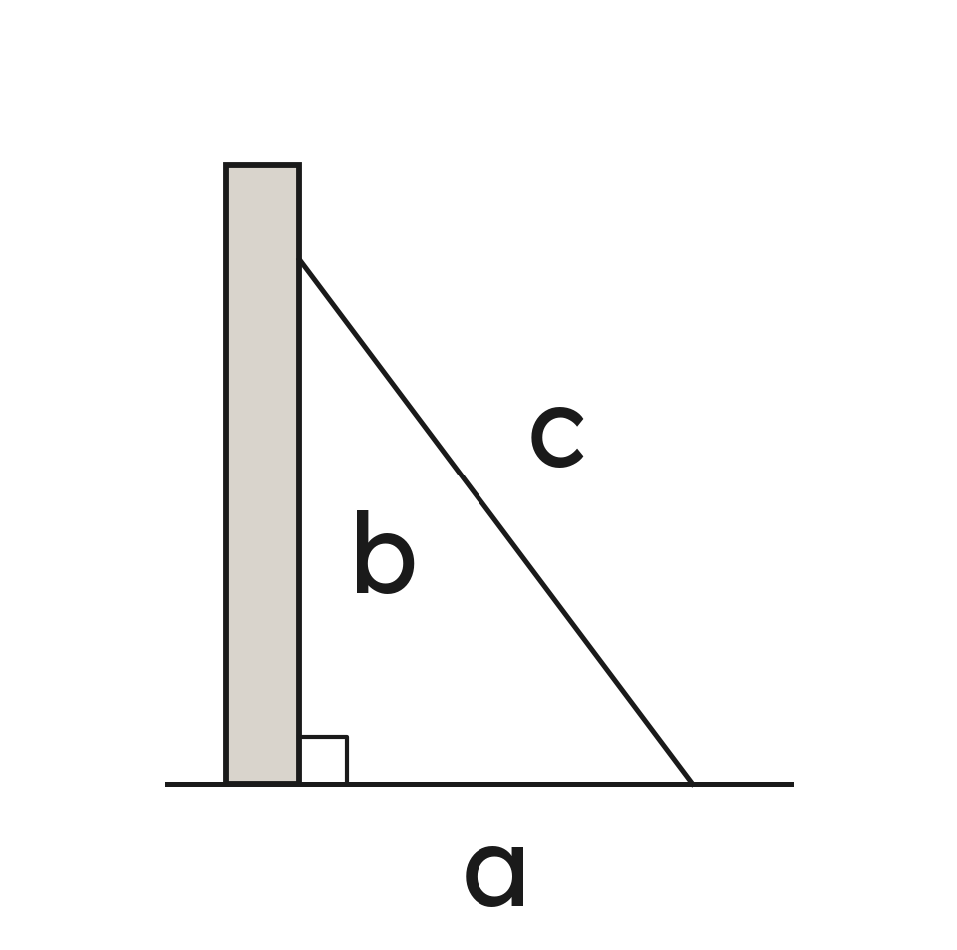
Notes
I. Find the right angle, then c
Sketch the story. Mark the right angle. The side across from it is c.
A ladder, a diagonal, a ramp, a kite string: each is the hypotenuse.
Grade 7 Accelerated · Unit 6 · Lesson 4 — Pythagorean Theorem in Real-World Problems
5

Slide 78
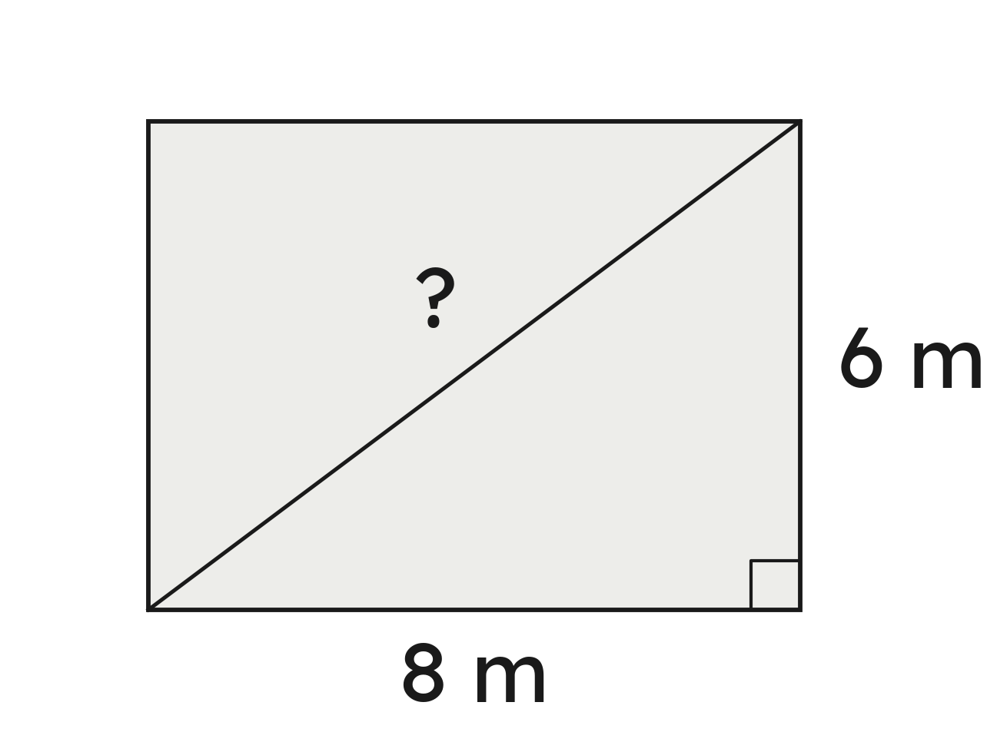
Notes
II. c in a story: the diagonal
The path is 10 m. Along two sides is 14 m: the path is 4 m shorter.
Grade 7 Accelerated · Unit 6 · Lesson 4 — Pythagorean Theorem in Real-World Problems
6

Slide 79
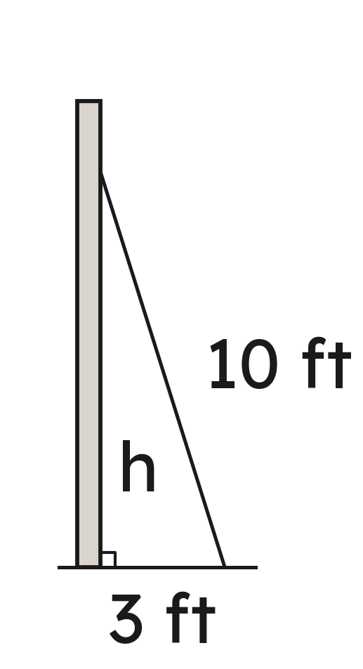
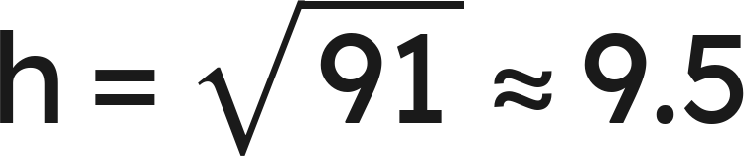
Notes
III. A leg in a story: how high
Grade 7 Accelerated · Unit 6 · Lesson 4 — Pythagorean Theorem in Real-World Problems
7

Slide 80
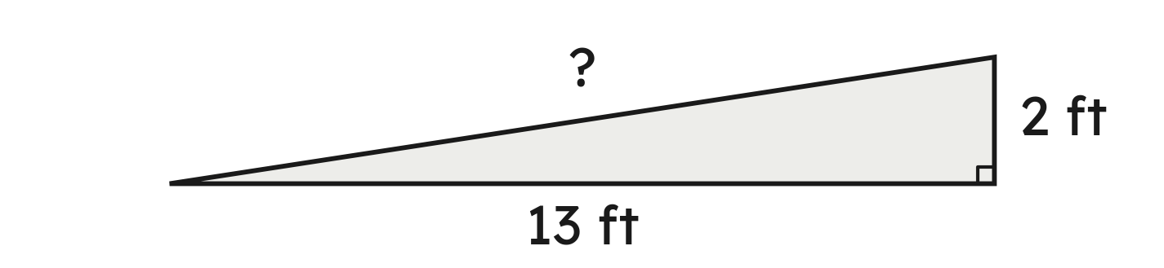
Example 1
A ramp rises 2 ft over a run of 13 ft along the ground.
How long is the ramp, to the nearest tenth of a foot?
Grade 7 Accelerated · Unit 6 · Lesson 4 — Pythagorean Theorem in Real-World Problems
8

Slide 81
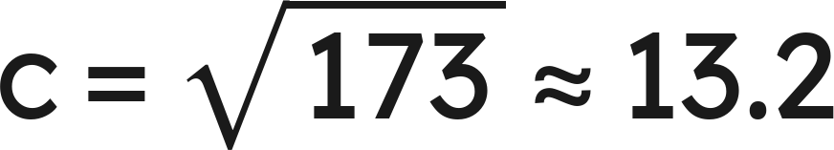
Example 1
Answer: The ramp is about 13.2 ft long.
Grade 7 Accelerated · Unit 6 · Lesson 4 — Pythagorean Theorem in Real-World Problems
9

Slide 82
Your Turn
A computer screen is 7 inches tall and 10 inches wide.
How long is its diagonal, to the nearest tenth of an inch?
Grade 7 Accelerated · Unit 6 · Lesson 4 — Pythagorean Theorem in Real-World Problems
10

Slide 83

Your Turn
A computer screen is 7 inches tall and 10 inches wide.
How long is its diagonal, to the nearest tenth of an inch?
Answer: About 12.2 in
Grade 7 Accelerated · Unit 6 · Lesson 4 — Pythagorean Theorem in Real-World Problems
11

Slide 84
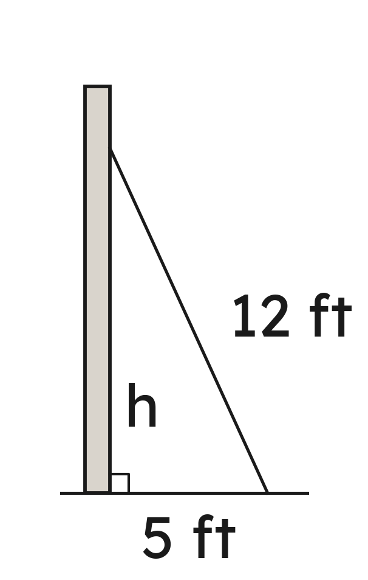
Example 2
A 12-ft ladder leans on a wall. Its foot is 5 ft from the wall.
How high up the wall does it reach, to the nearest tenth of a foot?
Grade 7 Accelerated · Unit 6 · Lesson 4 — Pythagorean Theorem in Real-World Problems
12

Slide 85
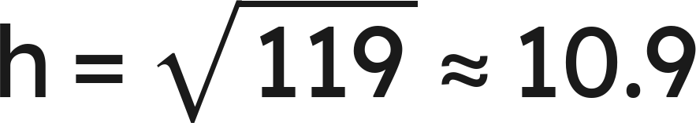
Example 2
Answer: It reaches about 10.9 ft up the wall.
Grade 7 Accelerated · Unit 6 · Lesson 4 — Pythagorean Theorem in Real-World Problems
13

Slide 86
Your Turn
A 13-ft ladder leans on a wall with its foot 6 ft from the wall.
How high does it reach, to the nearest tenth of a foot?
Grade 7 Accelerated · Unit 6 · Lesson 4 — Pythagorean Theorem in Real-World Problems
14

Slide 87
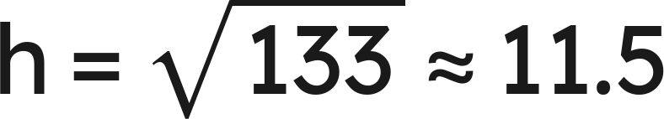
Your Turn
A 13-ft ladder leans on a wall with its foot 6 ft from the wall.
How high does it reach, to the nearest tenth of a foot?
Answer: About 11.5 ft
Grade 7 Accelerated · Unit 6 · Lesson 4 — Pythagorean Theorem in Real-World Problems
15

Slide 88
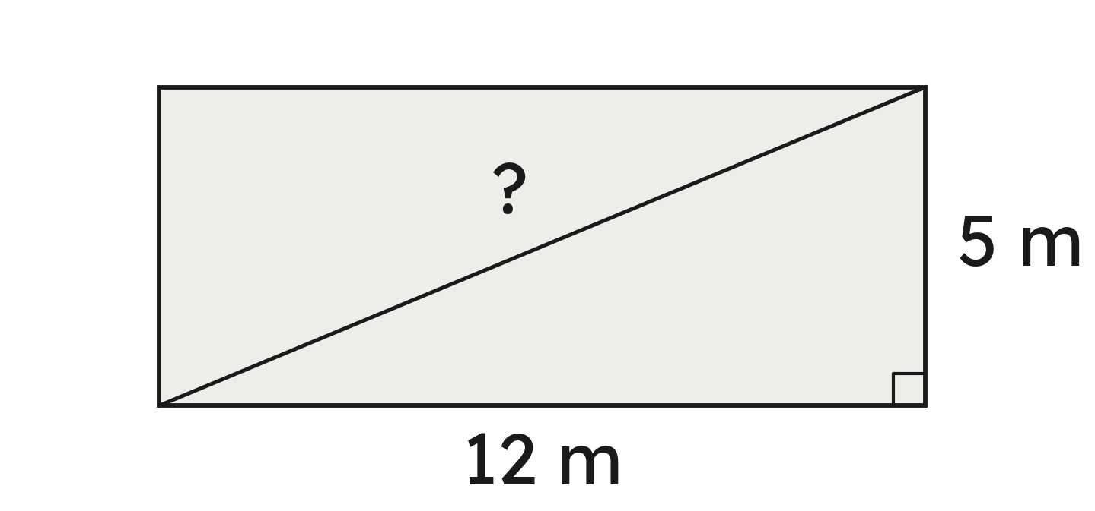
Whiteboards · Question 1 of 9
A swimming pool is 12 m long and 5 m wide.
How long is its diagonal?
Answer it.
Grade 7 Accelerated · Unit 6 · Lesson 4 — Pythagorean Theorem in Real-World Problems
16

Slide 89

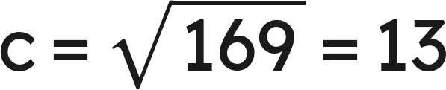
Whiteboards · Question 1 of 9
A swimming pool is 12 m long and 5 m wide.
How long is its diagonal?
Answer: 13 m
Grade 7 Accelerated · Unit 6 · Lesson 4 — Pythagorean Theorem in Real-World Problems
17

Slide 90
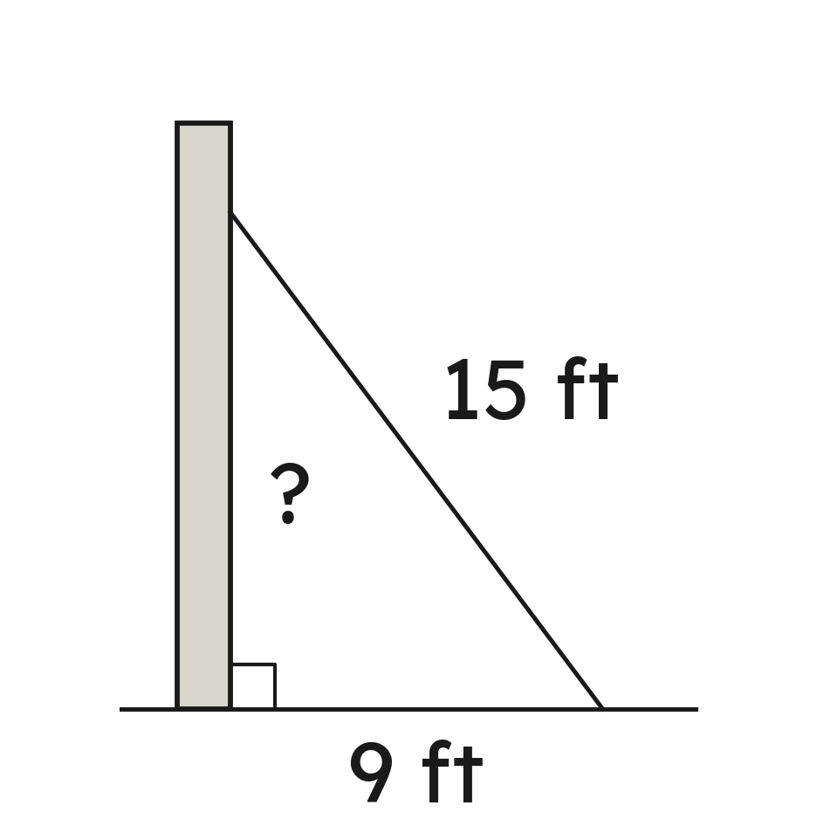
Whiteboards · Question 2 of 9
A 15-ft ladder leans on a wall. Its foot is 9 ft from the wall.
How high up the wall does it reach?
Answer it.
Grade 7 Accelerated · Unit 6 · Lesson 4 — Pythagorean Theorem in Real-World Problems
18

Slide 91

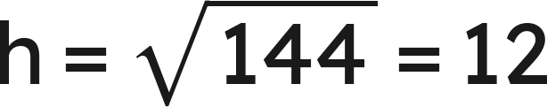
Whiteboards · Question 2 of 9
A 15-ft ladder leans on a wall. Its foot is 9 ft from the wall.
How high up the wall does it reach?
Answer: 12 ft
Grade 7 Accelerated · Unit 6 · Lesson 4 — Pythagorean Theorem in Real-World Problems
19

Slide 92
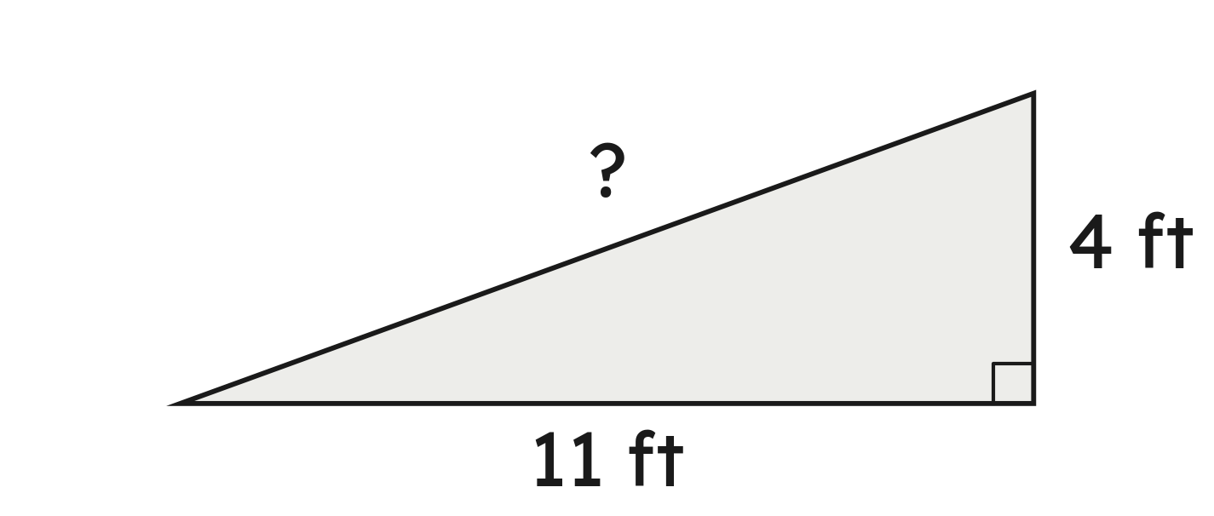
Whiteboards · Question 3 of 9
A ramp rises 4 ft over a run of 11 ft.
How long is the ramp, to the nearest tenth of a foot?
Answer it.
Grade 7 Accelerated · Unit 6 · Lesson 4 — Pythagorean Theorem in Real-World Problems
20

Slide 93


Whiteboards · Question 3 of 9
A ramp rises 4 ft over a run of 11 ft.
How long is the ramp, to the nearest tenth of a foot?
Answer: About 11.7 ft
Grade 7 Accelerated · Unit 6 · Lesson 4 — Pythagorean Theorem in Real-World Problems
21

Slide 94
Whiteboards · Question 4 of 9
A 26-ft ladder reaches 24 ft up a wall.
How far from the wall is its foot?
A. 10 ft
B. 35.4 ft
C. 2 ft
D. 100 ft
Answer it.
Grade 7 Accelerated · Unit 6 · Lesson 4 — Pythagorean Theorem in Real-World Problems
22

Slide 95
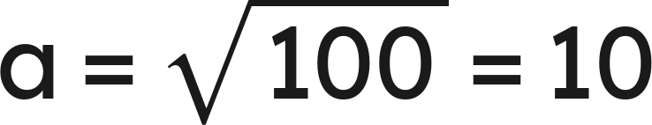
Whiteboards · Question 4 of 9
A 26-ft ladder reaches 24 ft up a wall.
How far from the wall is its foot?
Answer: A — 10 ft
Grade 7 Accelerated · Unit 6 · Lesson 4 — Pythagorean Theorem in Real-World Problems
23

Slide 96
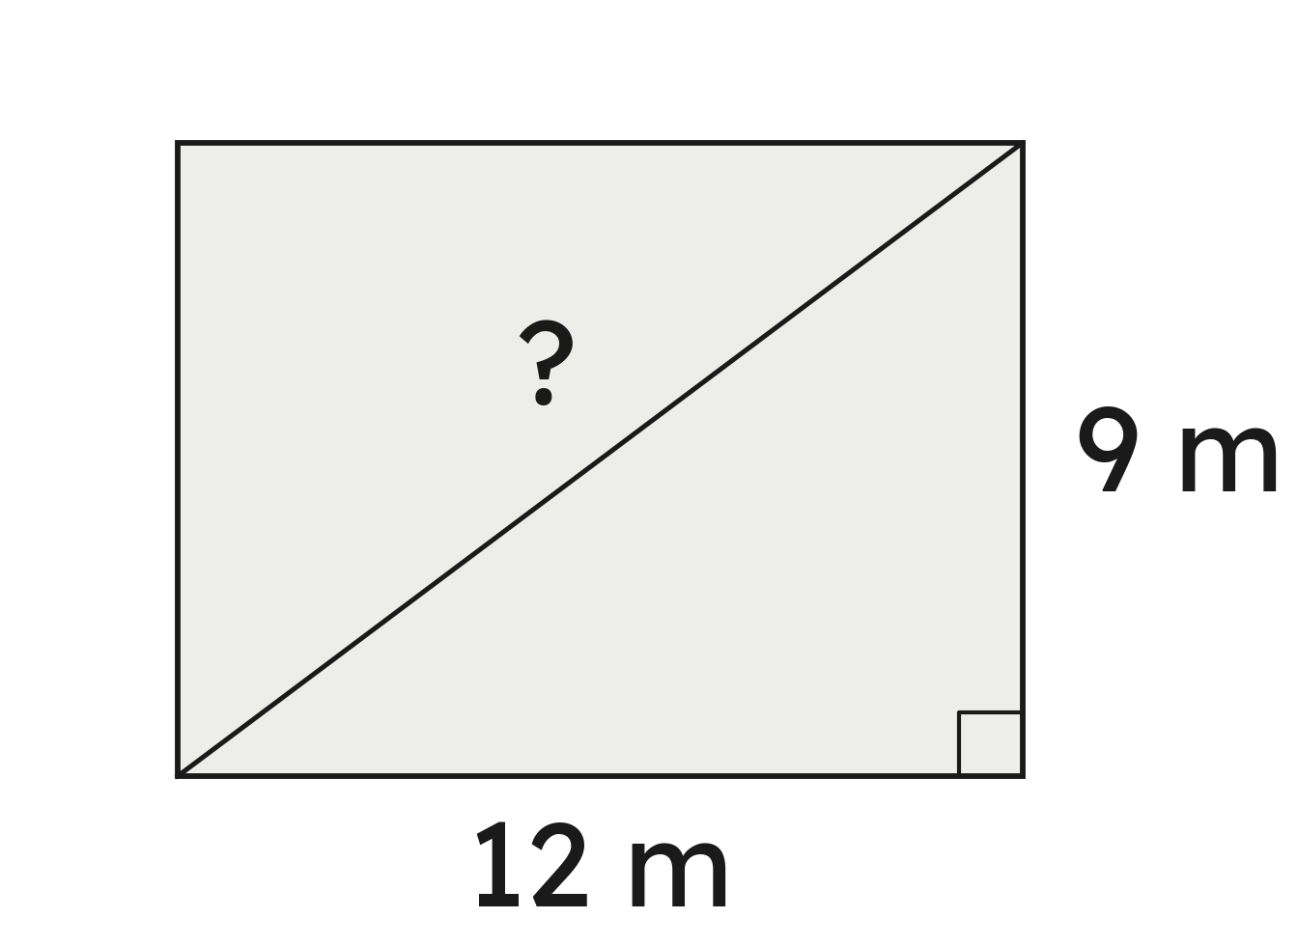
Whiteboards · Question 5 of 9
A lawn is 9 m by 12 m. Ben walks along two sides; Ava walks straight across, corner to corner.
How much shorter is Ava's walk?
Answer it.
Grade 7 Accelerated · Unit 6 · Lesson 4 — Pythagorean Theorem in Real-World Problems
24

Slide 97

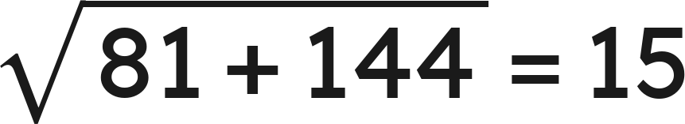

Whiteboards · Question 5 of 9
A lawn is 9 m by 12 m. Ben walks along two sides; Ava walks straight across, corner to corner.
How much shorter is Ava's walk?
Along two sides:
Across:
Answer: 6 m shorter
Grade 7 Accelerated · Unit 6 · Lesson 4 — Pythagorean Theorem in Real-World Problems
25

Slide 98
Whiteboards · Question 6 of 9
A drone is 30 m from Maya, straight above a spot on the ground 18 m from her.
Which length is the hypotenuse?
A. the 18 m on the ground
B. the drone's height
C. the 30 m to the drone
D. none: no right angle
Answer it.
Grade 7 Accelerated · Unit 6 · Lesson 4 — Pythagorean Theorem in Real-World Problems
26

Slide 99
Whiteboards · Question 6 of 9
A drone is 30 m from Maya, straight above a spot on the ground 18 m from her.
Which length is the hypotenuse?
The square corner is under the drone.
Across from it: the 30 m to the drone.
Answer: C — the 30 m to the drone
Grade 7 Accelerated · Unit 6 · Lesson 4 — Pythagorean Theorem in Real-World Problems
27

Slide 100
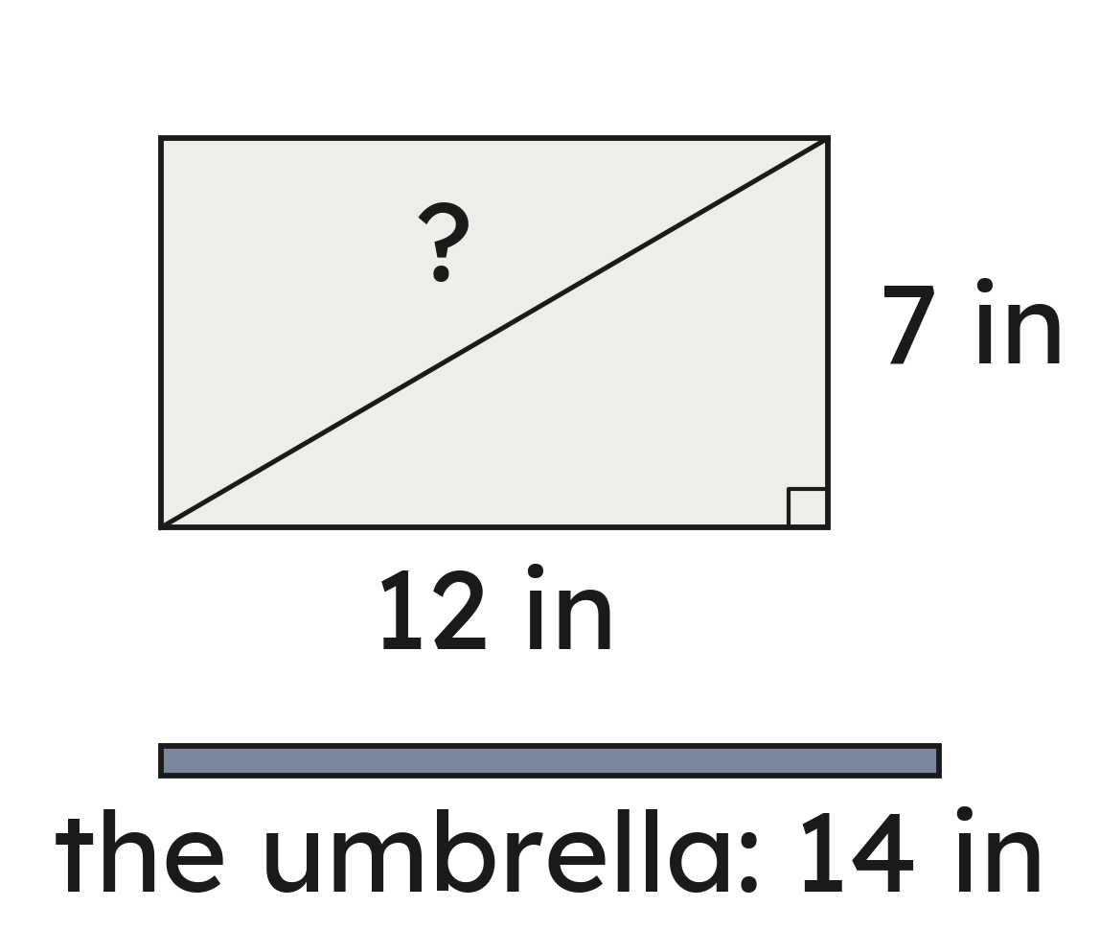
Whiteboards · Question 7 of 9
A box is 7 inches wide and 12 inches long.
Will a 14-in umbrella lie flat in it, corner to corner?
Answer it.
Grade 7 Accelerated · Unit 6 · Lesson 4 — Pythagorean Theorem in Real-World Problems
28

Slide 101


Whiteboards · Question 7 of 9
A box is 7 inches wide and 12 inches long.
Will a 14-in umbrella lie flat in it, corner to corner?
Answer: No — the diagonal is about 13.9 in.
Grade 7 Accelerated · Unit 6 · Lesson 4 — Pythagorean Theorem in Real-World Problems
29

Slide 102
Whiteboards · Question 8 of 9
A 10-ft ladder that weighs 25 pounds has its foot 7 ft from a wall.
How high does it reach, to the nearest tenth of a foot?
Answer it.
Grade 7 Accelerated · Unit 6 · Lesson 4 — Pythagorean Theorem in Real-World Problems
30

Slide 103


Whiteboards · Question 8 of 9
A 10-ft ladder that weighs 25 pounds has its foot 7 ft from a wall.
How high does it reach, to the nearest tenth of a foot?
Answer: About 7.1 ft
Grade 7 Accelerated · Unit 6 · Lesson 4 — Pythagorean Theorem in Real-World Problems
31

Slide 104
Whiteboards · Question 9 of 9
A window is 12 ft above the ground.
Why can an 11-ft ladder never reach it, wherever its foot stands?
Write your answer in sentences.
Grade 7 Accelerated · Unit 6 · Lesson 4 — Pythagorean Theorem in Real-World Problems
32

Slide 105
Whiteboards · Question 9 of 9
A window is 12 ft above the ground.
Why can an 11-ft ladder never reach it, wherever its foot stands?
The ladder is the hypotenuse, the longest side.
The height is a leg, so it is less than 11 ft.
Answer: The height is a leg — always shorter than the 11-ft ladder.
Grade 7 Accelerated · Unit 6 · Lesson 4 — Pythagorean Theorem in Real-World Problems
33

Slide 106
Independent Set
1.
A tablet screen is 5 inches wide and 8 inches tall. How long is its diagonal, to the nearest tenth of an inch?
2.
A fire truck's 50-ft ladder reaches 48 ft up a building. How far from the building is its foot?
3.
A ramp rises 3 ft over a run of 14 ft. How long is the ramp, to the nearest tenth of a foot?
4.
A park is 7 m by 11 m. How much shorter is the walk straight across, corner to corner, than the walk along two sides? Give it to the nearest tenth of a meter.
5.
Will a 10-in pencil lie flat in a box 7 inches by 8 inches, corner to corner?
6.
A kite flies on 19 m of tight string. It is straight above a spot 12 m from the hand that holds the string, level with the hand. How high above the hand is the kite, to the nearest tenth of a meter?
Grade 7 Accelerated · Unit 6 · Lesson 4 — Pythagorean Theorem in Real-World Problems
34

Slide 107
IXL
1.
Open IXL and start today's skills.
2.
Work on paper where the question needs work. The answer box does not show it.
3.
Every skill listed is required, to a SmartScore of 67. Due by the Unit 6 test.
Today's skills — all required
Pythagorean theorem: word problems — 87U
Grade 7 Accelerated · Unit 6 · Lesson 4 — Pythagorean Theorem in Real-World Problems
35

Slide 108
← Contents
GRADE 7 ACCELERATED · UNIT 6 · LESSON 5
Distance on the Coordinate Plane
MA.8.GR.1.2
I can find the distance between two points: subtract on a line, and draw the right triangle when the segment is slanted.
Grade 7 Accelerated · Unit 6 · Lesson 5 — Distance on the Coordinate Plane
1

Slide 109


Warm-Up
1. A 25-ft ladder reaches 20 ft up a wall. How far out is its foot?
2. Do sides of 12, 35 and 37 make a right triangle?
3. A map's scale is 1 cm : 5 km. Towns 3.4 cm apart are how far?
4. How far apart are
and
?
Grade 7 Accelerated · Unit 6 · Lesson 5 — Distance on the Coordinate Plane
2

Slide 110
Warm-Up
1. A 25-ft ladder reaches 20 ft up a wall. How far out is its foot?
15 ft
2. Do sides of 12, 35 and 37 make a right triangle?
Yes — 144 + 1,225 = 1,369 = 37²
3. A map's scale is 1 cm : 5 km. Towns 3.4 cm apart are how far?
17 km
4. How far apart are
and
?
8
Grade 7 Accelerated · Unit 6 · Lesson 5 — Distance on the Coordinate Plane
3

Slide 111
Vocabulary
horizontal distance
between two points with the same y: the difference of the x's
vertical distance
between two points with the same x: the difference of the y's
legs on the grid
the horizontal and vertical segments under a slanted one; the slanted segment is the hypotenuse
Grade 7 Accelerated · Unit 6 · Lesson 5 — Distance on the Coordinate Plane
4

Slide 112
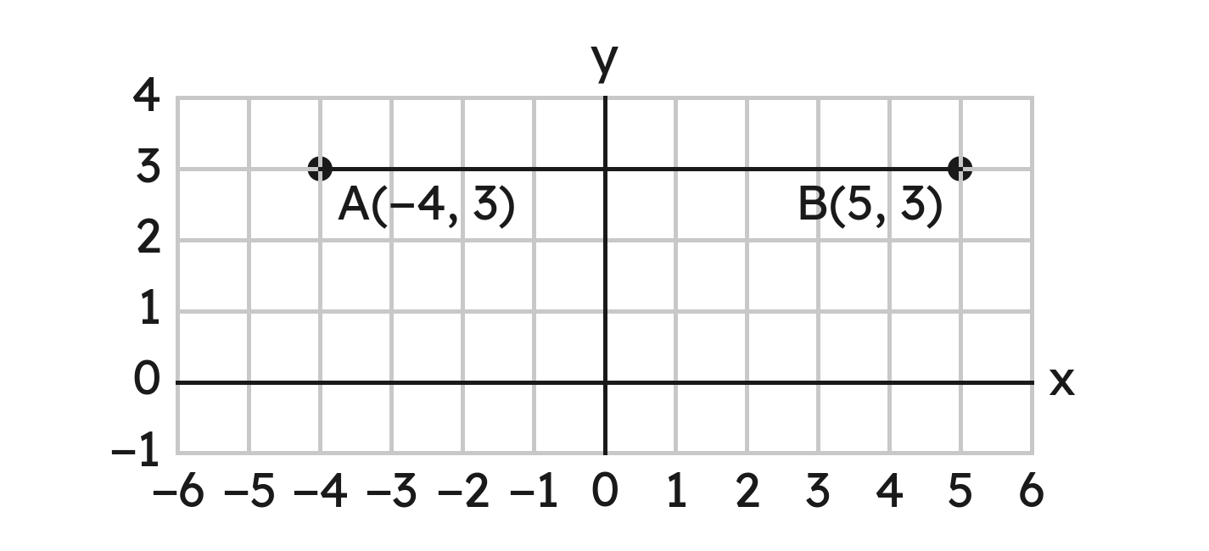
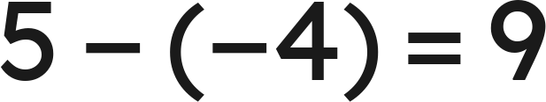
Notes
I. On one line: subtract — and across zero, add
Same y: subtract the x's. Same x: subtract the y's.
: across zero, 4 and 5 add.
Grade 7 Accelerated · Unit 6 · Lesson 5 — Distance on the Coordinate Plane
5

Slide 113
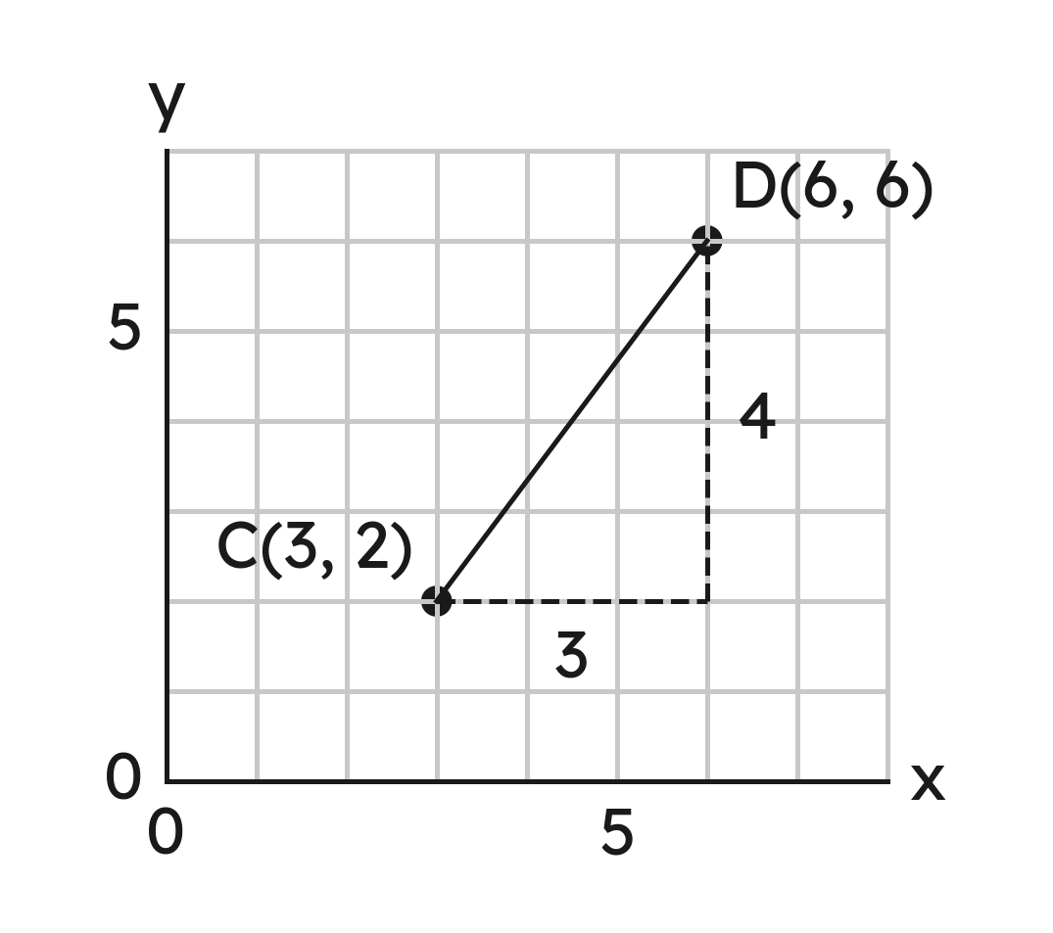


Notes
II. Slanted: draw the right triangle
,
The legs are the across and the up. The distance is the hypotenuse.
Grade 7 Accelerated · Unit 6 · Lesson 5 — Distance on the Coordinate Plane
6

Slide 114
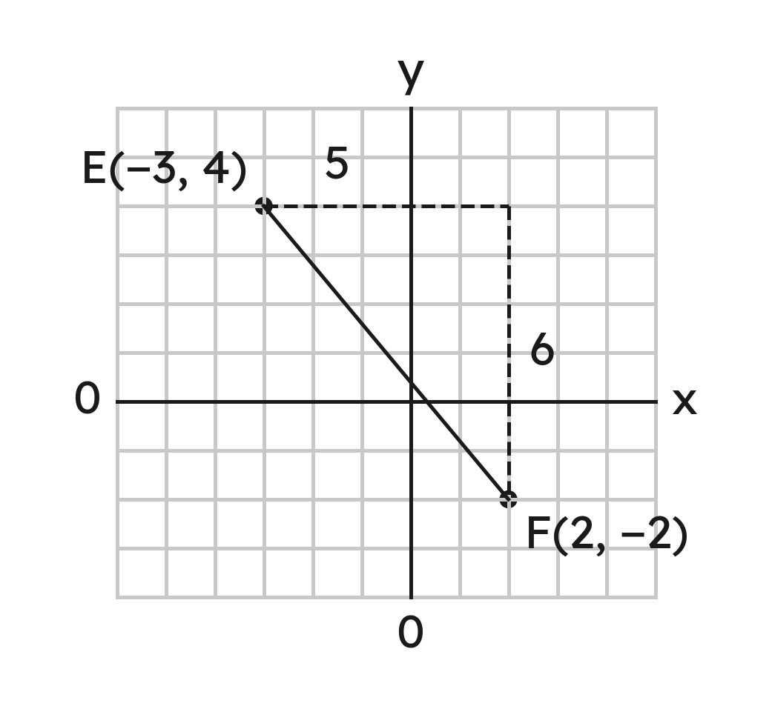
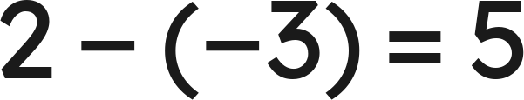
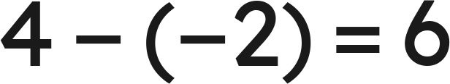

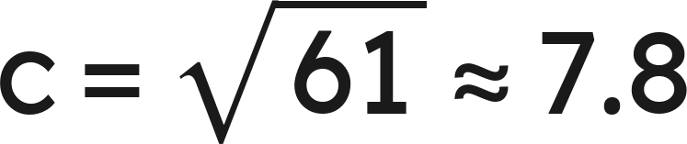
Notes
III. The legs come from the coordinates
across
down
,
Grade 7 Accelerated · Unit 6 · Lesson 5 — Distance on the Coordinate Plane
7

Slide 115


Example 1
Find the distance between
and
.
Grade 7 Accelerated · Unit 6 · Lesson 5 — Distance on the Coordinate Plane
8

Slide 116
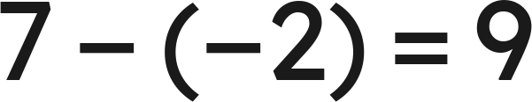

Example 1
Answer: 9 units
Grade 7 Accelerated · Unit 6 · Lesson 5 — Distance on the Coordinate Plane
9

Slide 117


Your Turn
Find the distance between
and
.
Grade 7 Accelerated · Unit 6 · Lesson 5 — Distance on the Coordinate Plane
10

Slide 118




Your Turn
Find the distance between
and
.
check:
Answer: 11 units
Grade 7 Accelerated · Unit 6 · Lesson 5 — Distance on the Coordinate Plane
11

Slide 119


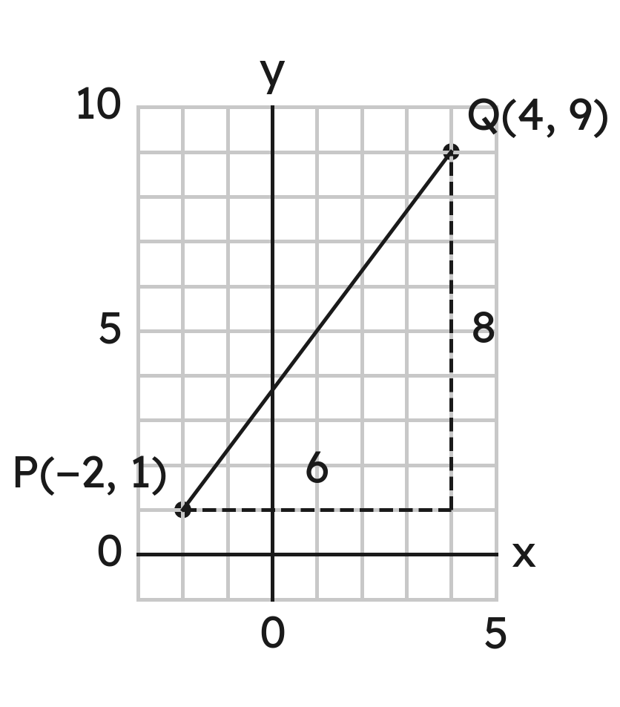
Example 2
Find the distance between
and
.
Grade 7 Accelerated · Unit 6 · Lesson 5 — Distance on the Coordinate Plane
12

Slide 120

Example 2
Answer: 10 units
Grade 7 Accelerated · Unit 6 · Lesson 5 — Distance on the Coordinate Plane
13

Slide 121


Your Turn
Find the distance between
and
, to the nearest tenth.
Grade 7 Accelerated · Unit 6 · Lesson 5 — Distance on the Coordinate Plane
14

Slide 122


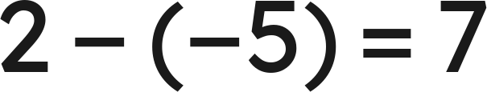
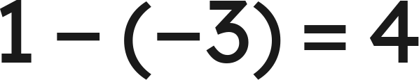


Your Turn
Find the distance between
and
, to the nearest tenth.
across
, up
,
Answer: √65 ≈ 8.1 units
Grade 7 Accelerated · Unit 6 · Lesson 5 — Distance on the Coordinate Plane
15

Slide 123


Whiteboards · Question 1 of 9
How far apart are
and
?
Answer it.
Grade 7 Accelerated · Unit 6 · Lesson 5 — Distance on the Coordinate Plane
16

Slide 124



Whiteboards · Question 1 of 9
How far apart are
and
?
Answer: 10 units
Grade 7 Accelerated · Unit 6 · Lesson 5 — Distance on the Coordinate Plane
17

Slide 125


Whiteboards · Question 2 of 9
How far apart are
and
?
Answer it.
Grade 7 Accelerated · Unit 6 · Lesson 5 — Distance on the Coordinate Plane
18

Slide 126



Whiteboards · Question 2 of 9
How far apart are
and
?
Answer: 12 units
Grade 7 Accelerated · Unit 6 · Lesson 5 — Distance on the Coordinate Plane
19

Slide 127


Whiteboards · Question 3 of 9
What is the distance between
and
?
A. 9
B. 8
C. 2
D. −8
Answer it.
Grade 7 Accelerated · Unit 6 · Lesson 5 — Distance on the Coordinate Plane
20

Slide 128



Whiteboards · Question 3 of 9
What is the distance between
and
?
Answer: B — 8 units
Grade 7 Accelerated · Unit 6 · Lesson 5 — Distance on the Coordinate Plane
21

Slide 129



Whiteboards · Question 4 of 9
How far apart are
and
?
Answer it.
Grade 7 Accelerated · Unit 6 · Lesson 5 — Distance on the Coordinate Plane
22

Slide 130



Whiteboards · Question 4 of 9
How far apart are
and
?
across 9, up 12
Answer: 15 units
Grade 7 Accelerated · Unit 6 · Lesson 5 — Distance on the Coordinate Plane
23

Slide 131



Whiteboards · Question 5 of 9
How far apart are
and
, to the nearest tenth?
Answer it.
Grade 7 Accelerated · Unit 6 · Lesson 5 — Distance on the Coordinate Plane
24

Slide 132




Whiteboards · Question 5 of 9
How far apart are
and
, to the nearest tenth?
across 5, up 8
Answer: √89 ≈ 9.4 units
Grade 7 Accelerated · Unit 6 · Lesson 5 — Distance on the Coordinate Plane
25

Slide 133






Whiteboards · Question 6 of 9
Which gives the distance between
and
?
A.
B.
C.
D.
Answer it.
Grade 7 Accelerated · Unit 6 · Lesson 5 — Distance on the Coordinate Plane
26

Slide 134





Whiteboards · Question 6 of 9
Which gives the distance between
and
?
across
, up
Answer: C — √(7² + 6²) = √85
Grade 7 Accelerated · Unit 6 · Lesson 5 — Distance on the Coordinate Plane
27

Slide 135

Whiteboards · Question 7 of 9
How far is
from the origin?
Answer it.
Grade 7 Accelerated · Unit 6 · Lesson 5 — Distance on the Coordinate Plane
28

Slide 136





Whiteboards · Question 7 of 9
How far is
from the origin?
across
, down
,
Answer: 13 units
Grade 7 Accelerated · Unit 6 · Lesson 5 — Distance on the Coordinate Plane
29

Slide 137



Whiteboards · Question 8 of 9
On a town map in miles, the school is at
,
the library at
and the town hall at
.
How far is the school from the library?
Answer it.
Grade 7 Accelerated · Unit 6 · Lesson 5 — Distance on the Coordinate Plane
30

Slide 138




Whiteboards · Question 8 of 9
On a town map in miles, the school is at
,
the library at
and the town hall at
.
How far is the school from the library?
Answer: 7 mi
Grade 7 Accelerated · Unit 6 · Lesson 5 — Distance on the Coordinate Plane
31

Slide 139


Whiteboards · Question 9 of 9
Ty says
and
are 4 units apart.
What did he do? What is the distance?
Write your answer in sentences.
Grade 7 Accelerated · Unit 6 · Lesson 5 — Distance on the Coordinate Plane
32

Slide 140




Whiteboards · Question 9 of 9
Ty says
and
are 4 units apart.
What did he do? What is the distance?
check:
Answer: He subtracted 7 − 3. Across zero the pieces add: 10 units.
Grade 7 Accelerated · Unit 6 · Lesson 5 — Distance on the Coordinate Plane
33

Slide 141











Independent Set
1.
Find the distance between
and
.
2.
Find the distance between
and
.
3.
Find the distance between
and
.
4.
Find the distance between
and
, to the nearest tenth.
5.
How far is
from the origin, to the nearest tenth?
6.
On a map in kilometers, a pool is at
and a park at
.
How far apart are they in a straight line, to the nearest tenth of a
kilometer?
Grade 7 Accelerated · Unit 6 · Lesson 5 — Distance on the Coordinate Plane
34

Slide 142
IXL
1.
Open IXL and start today's skills.
2.
Work on paper where the question needs work. The answer box does not show it.
3.
Every skill listed is required, to a SmartScore of 67. Due by the Unit 6 test.
Today's skills — all required
Find the distance between two points on a horizontal or vertical line — L9V
Find the distance between two points — ZBP
Grade 7 Accelerated · Unit 6 · Lesson 5 — Distance on the Coordinate Plane
35

Slide 143
← Contents
GRADE 7 ACCELERATED · UNIT 6 · LESSON 6
Real-World Coordinate-Plane Problems; Perimeter
MA.8.GR.1.2
I can find the perimeter of a figure on the coordinate plane, and a straight-line distance on a map.
Grade 7 Accelerated · Unit 6 · Lesson 6 — Real-World Coordinate-Plane Problems; Perimeter
1

Slide 144


Warm-Up
1. How far apart are
and
?
2. Legs of 2 m and 7 m. The hypotenuse, to the nearest tenth?
3. A map's scale is 1 in : 30 mi. Towns 2.5 in apart are how far?
4. The rectangle
,
,
,
: its perimeter?
Grade 7 Accelerated · Unit 6 · Lesson 6 — Real-World Coordinate-Plane Problems; Perimeter
2

Slide 145
Warm-Up
1. How far apart are
and
?
10 units
2. Legs of 2 m and 7 m. The hypotenuse, to the nearest tenth?
√53 ≈ 7.3 m
3. A map's scale is 1 in : 30 mi. Towns 2.5 in apart are how far?
75 mi
4. The rectangle
,
,
,
: its perimeter?
20 units
Grade 7 Accelerated · Unit 6 · Lesson 6 — Real-World Coordinate-Plane Problems; Perimeter
3

Slide 146
Vocabulary
perimeter
the distance around a figure: the sum of all its sides
height of a triangle
the segment from a corner straight to the opposite side, meeting it at a right angle
straight-line distance
the length of the one segment between two points — on a map, straight across, not along the streets
Grade 7 Accelerated · Unit 6 · Lesson 6 — Real-World Coordinate-Plane Problems; Perimeter
4

Slide 147


Notes
I. Perimeter: every side — a slanted one by its triangle
slanted side:
,
Grade 7 Accelerated · Unit 6 · Lesson 6 — Real-World Coordinate-Plane Problems; Perimeter
5

Slide 148



Notes
II. Along the streets, or straight
streets:
blocks
straight:
,
blocks
Grade 7 Accelerated · Unit 6 · Lesson 6 — Real-World Coordinate-Plane Problems; Perimeter
6

Slide 149



Notes
III. No right angle: split it — and round once, at the end
each slanted side:
,
Round once, at the end: 6 + 5.8 + 5.8 = 17.6 is short.
Grade 7 Accelerated · Unit 6 · Lesson 6 — Real-World Coordinate-Plane Problems; Perimeter
7

Slide 150




Example 1
Triangle DEF has corners
,
and
.
Find its perimeter.
Grade 7 Accelerated · Unit 6 · Lesson 6 — Real-World Coordinate-Plane Problems; Perimeter
8

Slide 151
Example 1
Answer: 24 units
Grade 7 Accelerated · Unit 6 · Lesson 6 — Real-World Coordinate-Plane Problems; Perimeter
9

Slide 152


Your Turn
Find the perimeter of the triangle with corners
,
and
.
Grade 7 Accelerated · Unit 6 · Lesson 6 — Real-World Coordinate-Plane Problems; Perimeter
10

Slide 153




Your Turn
Find the perimeter of the triangle with corners
,
and
.
across
, up
,
Answer: 36 units
Grade 7 Accelerated · Unit 6 · Lesson 6 — Real-World Coordinate-Plane Problems; Perimeter
11

Slide 154



Example 2
On a town map in blocks, Ana's home H is at
and the gym G at
.
How far along the streets? In a straight line, to the nearest tenth?
Grade 7 Accelerated · Unit 6 · Lesson 6 — Real-World Coordinate-Plane Problems; Perimeter
12

Slide 155

Example 2
Answer: 12 blocks along the streets; about 8.6 blocks straight
Grade 7 Accelerated · Unit 6 · Lesson 6 — Real-World Coordinate-Plane Problems; Perimeter
13

Slide 156


Your Turn
On a town map in blocks, Ben's home is at
and the park at
. How far is it along the streets?
In a straight line, to the nearest tenth?
Grade 7 Accelerated · Unit 6 · Lesson 6 — Real-World Coordinate-Plane Problems; Perimeter
14

Slide 157






Your Turn
On a town map in blocks, Ben's home is at
and the park at
. How far is it along the streets?
In a straight line, to the nearest tenth?
across
, down
: streets
straight:
,
Answer: 11 blocks along the streets; about 8.5 blocks straight
Grade 7 Accelerated · Unit 6 · Lesson 6 — Real-World Coordinate-Plane Problems; Perimeter
15

Slide 158




Whiteboards · Question 1 of 9
Triangle ABC has corners
,
and
.
Find its perimeter.
Answer it.
Grade 7 Accelerated · Unit 6 · Lesson 6 — Real-World Coordinate-Plane Problems; Perimeter
16

Slide 159







Whiteboards · Question 1 of 9
Triangle ABC has corners
,
and
.
Find its perimeter.
,
,
Answer: 30 units
Grade 7 Accelerated · Unit 6 · Lesson 6 — Real-World Coordinate-Plane Problems; Perimeter
17

Slide 160



Whiteboards · Question 2 of 9
A triangle has corners
,
and
.
Find its perimeter, to the nearest tenth.
Answer it.
Grade 7 Accelerated · Unit 6 · Lesson 6 — Real-World Coordinate-Plane Problems; Perimeter
18

Slide 161








Whiteboards · Question 2 of 9
A triangle has corners
,
and
.
Find its perimeter, to the nearest tenth.
,
,
Answer: 22.8 units
Grade 7 Accelerated · Unit 6 · Lesson 6 — Real-World Coordinate-Plane Problems; Perimeter
19

Slide 162




Whiteboards · Question 3 of 9
Triangle
,
,
has no right angle.
Find its perimeter.
Answer it.
Grade 7 Accelerated · Unit 6 · Lesson 6 — Real-World Coordinate-Plane Problems; Perimeter
20

Slide 163










Whiteboards · Question 3 of 9
Triangle
,
,
has no right angle.
Find its perimeter.
the height from C to
:
AC:
,
BC:
,
Answer: 42 units
Grade 7 Accelerated · Unit 6 · Lesson 6 — Real-World Coordinate-Plane Problems; Perimeter
21

Slide 164



Whiteboards · Question 4 of 9
What is the perimeter of the triangle with corners
,
and
, to the nearest tenth?
A. 11
B. 22
C. 76
D. 19.1
Answer it.
Grade 7 Accelerated · Unit 6 · Lesson 6 — Real-World Coordinate-Plane Problems; Perimeter
22

Slide 165








Whiteboards · Question 4 of 9
What is the perimeter of the triangle with corners
,
and
, to the nearest tenth?
and
on grid lines
,
Answer: D — 19.1 units
Grade 7 Accelerated · Unit 6 · Lesson 6 — Real-World Coordinate-Plane Problems; Perimeter
23

Slide 166


Whiteboards · Question 5 of 9
On a map in blocks, the library is at
and the pool at
.
How much shorter is the straight line than the streets?
Answer it.
Grade 7 Accelerated · Unit 6 · Lesson 6 — Real-World Coordinate-Plane Problems; Perimeter
24

Slide 167





Whiteboards · Question 5 of 9
On a map in blocks, the library is at
and the pool at
.
How much shorter is the straight line than the streets?
streets:
straight:
,
Answer: 4 blocks shorter
Grade 7 Accelerated · Unit 6 · Lesson 6 — Real-World Coordinate-Plane Problems; Perimeter
25

Slide 168



Whiteboards · Question 6 of 9
How long is a diagonal of the rectangle with corners
,
,
and
?
A. 15
B. 21
C. 42
D. 10
Answer it.
Grade 7 Accelerated · Unit 6 · Lesson 6 — Real-World Coordinate-Plane Problems; Perimeter
26

Slide 169







Whiteboards · Question 6 of 9
How long is a diagonal of the rectangle with corners
,
,
and
?
sides
and
,
Answer: A — 15 units
Grade 7 Accelerated · Unit 6 · Lesson 6 — Real-World Coordinate-Plane Problems; Perimeter
27

Slide 170


Whiteboards · Question 7 of 9
On a park map in meters, the fountain is at
and the gate at
.
How far is it straight across, to the nearest tenth?
Answer it.
Grade 7 Accelerated · Unit 6 · Lesson 6 — Real-World Coordinate-Plane Problems; Perimeter
28

Slide 171




Whiteboards · Question 7 of 9
On a park map in meters, the fountain is at
and the gate at
.
How far is it straight across, to the nearest tenth?
across
, down
,
Answer: √106 ≈ 10.3 m
Grade 7 Accelerated · Unit 6 · Lesson 6 — Real-World Coordinate-Plane Problems; Perimeter
29

Slide 172



Whiteboards · Question 8 of 9
On a trail map in miles, the camp is at
,
the lake at
and the trailhead at
.
How far is the camp from the lake, in a straight line?
Answer it.
Grade 7 Accelerated · Unit 6 · Lesson 6 — Real-World Coordinate-Plane Problems; Perimeter
30

Slide 173




Whiteboards · Question 8 of 9
On a trail map in miles, the camp is at
,
the lake at
and the trailhead at
.
How far is the camp from the lake, in a straight line?
across
, up
,
Answer: 13 mi
Grade 7 Accelerated · Unit 6 · Lesson 6 — Real-World Coordinate-Plane Problems; Perimeter
31

Slide 174

Whiteboards · Question 9 of 9
Mia says the segment from
to
is 3 units long,
because it crosses 3 grid squares.
Is she right? Explain, and find its length to the nearest tenth.
Write your answer in sentences.
Grade 7 Accelerated · Unit 6 · Lesson 6 — Real-World Coordinate-Plane Problems; Perimeter
32

Slide 175




Whiteboards · Question 9 of 9
Mia says the segment from
to
is 3 units long,
because it crosses 3 grid squares.
Is she right? Explain, and find its length to the nearest tenth.
across
, up
,
Answer: No: it is the hypotenuse of a triangle with legs 3 and 1, √10 ≈ 3.2 units.
Grade 7 Accelerated · Unit 6 · Lesson 6 — Real-World Coordinate-Plane Problems; Perimeter
33

Slide 176


















Independent Set
1.
Find the perimeter of the triangle
,
,
. It has no right angle.
2.
Find the perimeter of the triangle
,
,
, to the nearest tenth.
3.
Find the perimeter of the parallelogram
,
,
,
.
4.
On a map in blocks, Kai's home is at
and his school at
. How much
shorter is the straight line than the streets?
5.
On a map in miles, a dock is at
and an island at
. How far apart are
they, to the nearest tenth?
6.
A rectangle has corners
,
,
and
. How long is a
diagonal?
Grade 7 Accelerated · Unit 6 · Lesson 6 — Real-World Coordinate-Plane Problems; Perimeter
34

Slide 177
IXL
1.
Open IXL and start today's skills.
2.
Work on paper where the question needs work. The answer box does not show it.
3.
Every skill listed is required, to a SmartScore of 67. Due by the Unit 6 test.
Today's skills — all required
Pythagorean theorem: find the perimeter — VGE
Grade 7 Accelerated · Unit 6 · Lesson 6 — Real-World Coordinate-Plane Problems; Perimeter
35

Slide 178
← Contents
GRADE 7 ACCELERATED · UNIT 6 · LESSONS 7–8
Similar Triangles; Indirect Measurement
MA.8.GR.2.4
I can find a missing side of similar triangles with the scale factor, and use similar triangles to measure what I cannot reach.
Grade 7 Accelerated · Unit 6 · Lessons 7–8 — Similar Triangles; Indirect Measurement
1

Slide 179

Warm-Up
1. The triangle
,
,
: its perimeter, to the tenth?
2. A 10-ft ladder's foot is 6 ft from a wall. How high does it reach?
3. A 10 cm side is 4 cm in a copy. What is the scale factor?
4. At 1 in : 6 ft, a 3.5-in wall on a drawing is how long?
Grade 7 Accelerated · Unit 6 · Lessons 7–8 — Similar Triangles; Indirect Measurement
2

Slide 180
Warm-Up
1. The triangle
,
,
: its perimeter, to the tenth?
8.6 units
2. A 10-ft ladder's foot is 6 ft from a wall. How high does it reach?
8 ft
3. A 10 cm side is 4 cm in a copy. What is the scale factor?
k = 0.4
4. At 1 in : 6 ft, a 3.5-in wall on a drawing is how long?
21 ft
Grade 7 Accelerated · Unit 6 · Lessons 7–8 — Similar Triangles; Indirect Measurement
3

Slide 181
Vocabulary
similar triangles
the same shape, any size: matching angles equal, and every side multiplied by the same number
corresponding sides
sides that match — across from equal angles: shortest with shortest, longest with longest
scale factor k
copy ÷ original, for one matching pair of sides
indirect measurement
finding a length you cannot reach from similar triangles you can measure
Grade 7 Accelerated · Unit 6 · Lessons 7–8 — Similar Triangles; Indirect Measurement
4

Slide 182




Notes
I. Similar: every side times the same k
,
,
Three ratios, all equal: similar. Match shortest to shortest, longest to longest.
Grade 7 Accelerated · Unit 6 · Lessons 7–8 — Similar Triangles; Indirect Measurement
5

Slide 183





Notes
II. A missing side: find k, then multiply
,
,
The order of the letters is the matching: A with D, B with E, C with F.
Grade 7 Accelerated · Unit 6 · Lessons 7–8 — Similar Triangles; Indirect Measurement
6

Slide 184



Notes
III. Same sun, same angle: shadows
ft
Grade 7 Accelerated · Unit 6 · Lessons 7–8 — Similar Triangles; Indirect Measurement
7

Slide 185

Example 1
The two triangles are similar.
Find x and y.
Grade 7 Accelerated · Unit 6 · Lessons 7–8 — Similar Triangles; Indirect Measurement
8

Slide 186

Example 1
Answer: x = 21, y = 27
Grade 7 Accelerated · Unit 6 · Lessons 7–8 — Similar Triangles; Indirect Measurement
9

Slide 187
Your Turn
A triangle has sides 3, 5 and 7.
A similar triangle has sides 28, x and 12. Find x.
Grade 7 Accelerated · Unit 6 · Lessons 7–8 — Similar Triangles; Indirect Measurement
10

Slide 188



Your Turn
A triangle has sides 3, 5 and 7.
A similar triangle has sides 28, x and 12. Find x.
and
: one k
so x matches the 5:
Answer: x = 20
Grade 7 Accelerated · Unit 6 · Lessons 7–8 — Similar Triangles; Indirect Measurement
11

Slide 189

Example 2
Omar's eyes are 5 ft up, 4 ft from a mirror on the ground.
In it he sees the top of a tree 18 ft beyond the mirror.
The two right triangles are similar.
How tall is the tree?
Grade 7 Accelerated · Unit 6 · Lessons 7–8 — Similar Triangles; Indirect Measurement
12

Slide 190


Example 2
Answer: The tree is 22.5 ft tall.
Grade 7 Accelerated · Unit 6 · Lessons 7–8 — Similar Triangles; Indirect Measurement
13

Slide 191
Your Turn
Ana's eyes are 4 ft up, 1.5 ft from a mirror on the ground.
In it she sees the top of a flagpole 12 ft beyond the mirror.
The two right triangles are similar. How tall is the flagpole?
Grade 7 Accelerated · Unit 6 · Lessons 7–8 — Similar Triangles; Indirect Measurement
14

Slide 192


Your Turn
Ana's eyes are 4 ft up, 1.5 ft from a mirror on the ground.
In it she sees the top of a flagpole 12 ft beyond the mirror.
The two right triangles are similar. How tall is the flagpole?
Answer: 32 ft
Grade 7 Accelerated · Unit 6 · Lessons 7–8 — Similar Triangles; Indirect Measurement
15

Slide 193
Whiteboards · Question 1 of 9
Are triangles with sides 8, 12, 14 and 12, 18, 21 similar?
Answer it.
Grade 7 Accelerated · Unit 6 · Lessons 7–8 — Similar Triangles; Indirect Measurement
16

Slide 194



Whiteboards · Question 1 of 9
Are triangles with sides 8, 12, 14 and 12, 18, 21 similar?
,
,
all three equal
Answer: Yes — every ratio is 1.5
Grade 7 Accelerated · Unit 6 · Lessons 7–8 — Similar Triangles; Indirect Measurement
17

Slide 195

Whiteboards · Question 2 of 9
Triangle ABC is similar to triangle DEF.
Find x.
Answer it.
Grade 7 Accelerated · Unit 6 · Lessons 7–8 — Similar Triangles; Indirect Measurement
18

Slide 196



Whiteboards · Question 2 of 9
Triangle ABC is similar to triangle DEF.
Find x.
the names: AC with DF, BC with EF, AB with DE
Answer: x = 24
Grade 7 Accelerated · Unit 6 · Lessons 7–8 — Similar Triangles; Indirect Measurement
19

Slide 197
Whiteboards · Question 3 of 9
A triangle has sides of 12, 16 and 20 inches.
A similar triangle's longest side is 5 inches.
Find its other two sides.
Answer it.
Grade 7 Accelerated · Unit 6 · Lessons 7–8 — Similar Triangles; Indirect Measurement
20

Slide 198



Whiteboards · Question 3 of 9
A triangle has sides of 12, 16 and 20 inches.
A similar triangle's longest side is 5 inches.
Find its other two sides.
,
Answer: 3 inches and 4 inches
Grade 7 Accelerated · Unit 6 · Lessons 7–8 — Similar Triangles; Indirect Measurement
21

Slide 199

Whiteboards · Question 4 of 9
Similar triangles: which side of the second matches the 9?
A. 8
B. 16
C. 12
D. none of them
Answer it.
Grade 7 Accelerated · Unit 6 · Lessons 7–8 — Similar Triangles; Indirect Measurement
22

Slide 200

Whiteboards · Question 4 of 9
Similar triangles: which side of the second matches the 9?
sorted: 6, 9, 12 and 8, 12, 16
the middle sides match: 9 and 12
Answer: C — the 12
Grade 7 Accelerated · Unit 6 · Lessons 7–8 — Similar Triangles; Indirect Measurement
23

Slide 201
Whiteboards · Question 5 of 9
Which triangle is similar to one with sides 5, 6 and 8?
A. 7, 8, 10
B. 10, 12, 16
C. 10, 12, 15
D. 5, 6, 9
Answer it.
Grade 7 Accelerated · Unit 6 · Lessons 7–8 — Similar Triangles; Indirect Measurement
24

Slide 202



Whiteboards · Question 5 of 9
Which triangle is similar to one with sides 5, 6 and 8?
,
,
one k for every side
Answer: B — 10, 12, 16
Grade 7 Accelerated · Unit 6 · Lessons 7–8 — Similar Triangles; Indirect Measurement
25

Slide 203

Whiteboards · Question 6 of 9
A 4-ft post casts a 2.5-ft shadow as a tree casts a 15-ft shadow.
How tall is the tree?
Answer it.
Grade 7 Accelerated · Unit 6 · Lessons 7–8 — Similar Triangles; Indirect Measurement
26

Slide 204


Whiteboards · Question 6 of 9
A 4-ft post casts a 2.5-ft shadow as a tree casts a 15-ft shadow.
How tall is the tree?
Answer: 24 ft
Grade 7 Accelerated · Unit 6 · Lessons 7–8 — Similar Triangles; Indirect Measurement
27

Slide 205

Whiteboards · Question 7 of 9
A ramp rises 0.6 m over its first 2 m from A. The right triangles are similar.
How high is the ramp 8 m from A?
Answer it.
Grade 7 Accelerated · Unit 6 · Lessons 7–8 — Similar Triangles; Indirect Measurement
28

Slide 206


Whiteboards · Question 7 of 9
A ramp rises 0.6 m over its first 2 m from A. The right triangles are similar.
How high is the ramp 8 m from A?
Answer: 2.4 m
Grade 7 Accelerated · Unit 6 · Lessons 7–8 — Similar Triangles; Indirect Measurement
29

Slide 207

Whiteboards · Question 8 of 9
Lena's eyes are 5.5 ft up. In a 10-inch mirror on the ground 6 ft away, she sees the top of a flagpole 24 ft past the mirror.
The two right triangles are similar. How tall is the flagpole?
Answer it.
Grade 7 Accelerated · Unit 6 · Lessons 7–8 — Similar Triangles; Indirect Measurement
30

Slide 208


Whiteboards · Question 8 of 9
Lena's eyes are 5.5 ft up. In a 10-inch mirror on the ground 6 ft away, she sees the top of a flagpole 24 ft past the mirror.
The two right triangles are similar. How tall is the flagpole?
Answer: 22 ft
Grade 7 Accelerated · Unit 6 · Lessons 7–8 — Similar Triangles; Indirect Measurement
31

Slide 209
Whiteboards · Question 9 of 9
Kim says triangles with sides 3, 4, 5 and 5, 6, 7 are similar,
because each side grew by 2.
Is she right? Explain.
Write your answer in sentences.
Grade 7 Accelerated · Unit 6 · Lessons 7–8 — Similar Triangles; Indirect Measurement
32

Slide 210



Whiteboards · Question 9 of 9
Kim says triangles with sides 3, 4, 5 and 5, 6, 7 are similar,
because each side grew by 2.
Is she right? Explain.
,
,
: three ratios
Answer: No — similar means × one k, not + 2.
Grade 7 Accelerated · Unit 6 · Lessons 7–8 — Similar Triangles; Indirect Measurement
33

Slide 211
Independent Set
1.
Are triangles with sides 4, 10, 12 and 6, 15, 20 similar? Show the three ratios.
2.
Triangle PQR is similar to triangle XYZ. PQ is 8, QR is 10 and PR is 13, and XY is 20. Find YZ and XZ.
3.
A triangle has sides 15, 25 and 30. A similar triangle's longest side is 6. Find its other two sides.
4.
A 1.5-m child casts a 2-m shadow. At the same moment a tree casts a 14-m shadow. How tall is the tree?
5.
The two right triangles are similar and share corner A. The small one runs 3 m along the ground from A and stands 1.2 m high. The big one runs 12 m along the ground from A. How high is it?
6.
Which is similar to a triangle with sides 8, 10 and 14: one with sides 10, 12, 16, or one with sides 12, 15, 21? Show why.
Grade 7 Accelerated · Unit 6 · Lessons 7–8 — Similar Triangles; Indirect Measurement
34

Slide 212
IXL
1.
Open IXL and start today's skills.
2.
Work on paper where the question needs work. The answer box does not show it.
3.
Every skill listed is required, to a SmartScore of 67. Due by the Unit 6 test.
Today's skills — all required
Side lengths of similar triangles — QSK
Similar triangles and indirect measurement — 88W
Identify similar triangles — 6PD
Grade 7 Accelerated · Unit 6 · Lessons 7–8 — Similar Triangles; Indirect Measurement
35

Slide 213
← Contents
GRADE 7 ACCELERATED · UNIT 6 · THREAD B · DAY 1
Angle Pairs: Supplementary, Complementary, Vertical, Adjacent
MA.8.GR.1.4
I can name an angle pair and use it to find a missing angle, with an equation when the angles are expressions.
Grade 7 Accelerated · Unit 6 · Thread B · Day 1 — Angle Pairs: Supplementary, Complementary, Vertical, Adjacent
1

Slide 214


Warm-Up
1. A 6-ft man casts a 4-ft shadow; a tree, 18 ft. The tree's height?
2. How far apart are
and
?
3. Ana types 210 words in 5 minutes. Words per minute?
4. Two angles make a straight angle. One is 130°. The other?
Grade 7 Accelerated · Unit 6 · Thread B · Day 1 — Angle Pairs: Supplementary, Complementary, Vertical, Adjacent
2

Slide 215
Warm-Up
1. A 6-ft man casts a 4-ft shadow; a tree, 18 ft. The tree's height?
27 ft
2. How far apart are
and
?
9 units
3. Ana types 210 words in 5 minutes. Words per minute?
42
4. Two angles make a straight angle. One is 130°. The other?
50°
Grade 7 Accelerated · Unit 6 · Thread B · Day 1 — Angle Pairs: Supplementary, Complementary, Vertical, Adjacent
3

Slide 216
Vocabulary
adjacent angles
two angles with the same vertex and a shared side, that do not overlap
vertical angles
the angles across from each other where two lines cross; they are equal
complementary angles
two angles that add to 90°
supplementary angles
two angles that add to 180°; a linear pair — two adjacent angles on a straight line — is supplementary
Grade 7 Accelerated · Unit 6 · Thread B · Day 1 — Angle Pairs: Supplementary, Complementary, Vertical, Adjacent
4

Slide 217


Notes
I. Adjacent and vertical
Adjacent: one vertex, a shared side, no overlap — angles 1 and 2.
Vertical: across, and equal. m means measure:
.
Grade 7 Accelerated · Unit 6 · Thread B · Day 1 — Angle Pairs: Supplementary, Complementary, Vertical, Adjacent
5

Slide 218

Notes
II. Complementary and supplementary
Complementary: add to 90°. Supplementary: add to 180°.
A linear pair is supplementary: 60° + 120° = 180°.
Grade 7 Accelerated · Unit 6 · Thread B · Day 1 — Angle Pairs: Supplementary, Complementary, Vertical, Adjacent
6

Slide 219




Notes
III. Name the pair, write the equation, put x back
,
,
the angle:
Grade 7 Accelerated · Unit 6 · Thread B · Day 1 — Angle Pairs: Supplementary, Complementary, Vertical, Adjacent
7

Slide 220



Example 1
A ray splits a right angle into
and
.
Find x and both angles.
Grade 7 Accelerated · Unit 6 · Thread B · Day 1 — Angle Pairs: Supplementary, Complementary, Vertical, Adjacent
8

Slide 221

Example 1
Answer: x = 17; the angles are 50° and 40°
Grade 7 Accelerated · Unit 6 · Thread B · Day 1 — Angle Pairs: Supplementary, Complementary, Vertical, Adjacent
9

Slide 222


Your Turn
and
are complementary.
Find x and both angles.
Grade 7 Accelerated · Unit 6 · Thread B · Day 1 — Angle Pairs: Supplementary, Complementary, Vertical, Adjacent
10

Slide 223







Your Turn
and
are complementary.
Find x and both angles.
,
,
,
Answer: x = 16; 64° and 26°
Grade 7 Accelerated · Unit 6 · Thread B · Day 1 — Angle Pairs: Supplementary, Complementary, Vertical, Adjacent
11

Slide 224



Example 2
Two lines cross. Vertical angles measure
and
.
Find the measure of each angle.
Grade 7 Accelerated · Unit 6 · Thread B · Day 1 — Angle Pairs: Supplementary, Complementary, Vertical, Adjacent
12

Slide 225




Example 2
Answer: Each angle is 38°.
Grade 7 Accelerated · Unit 6 · Thread B · Day 1 — Angle Pairs: Supplementary, Complementary, Vertical, Adjacent
13

Slide 226


Your Turn
Vertical angles measure
and
.
Find the measure of each angle.
Grade 7 Accelerated · Unit 6 · Thread B · Day 1 — Angle Pairs: Supplementary, Complementary, Vertical, Adjacent
14

Slide 227






Your Turn
Vertical angles measure
and
.
Find the measure of each angle.
equal: 4x + 3 = x + 39
take x off both sides:
,
Answer: Each angle is 51°.
Grade 7 Accelerated · Unit 6 · Thread B · Day 1 — Angle Pairs: Supplementary, Complementary, Vertical, Adjacent
15

Slide 228
Whiteboards · Question 1 of 9
What is the complement of 34°?
Answer it.
Grade 7 Accelerated · Unit 6 · Thread B · Day 1 — Angle Pairs: Supplementary, Complementary, Vertical, Adjacent
16

Slide 229

Whiteboards · Question 1 of 9
What is the complement of 34°?
Answer: 56°
Grade 7 Accelerated · Unit 6 · Thread B · Day 1 — Angle Pairs: Supplementary, Complementary, Vertical, Adjacent
17

Slide 230
Whiteboards · Question 2 of 9
What is the supplement of 112°?
Answer it.
Grade 7 Accelerated · Unit 6 · Thread B · Day 1 — Angle Pairs: Supplementary, Complementary, Vertical, Adjacent
18

Slide 231

Whiteboards · Question 2 of 9
What is the supplement of 112°?
Answer: 68°
Grade 7 Accelerated · Unit 6 · Thread B · Day 1 — Angle Pairs: Supplementary, Complementary, Vertical, Adjacent
19

Slide 232

Whiteboards · Question 3 of 9
Two lines cross. One angle is 47°.
Find a and b.
Answer it.
Grade 7 Accelerated · Unit 6 · Thread B · Day 1 — Angle Pairs: Supplementary, Complementary, Vertical, Adjacent
20

Slide 233

Whiteboards · Question 3 of 9
Two lines cross. One angle is 47°.
Find a and b.
vertical:
a linear pair:
Answer: a = 47°, b = 133°
Grade 7 Accelerated · Unit 6 · Thread B · Day 1 — Angle Pairs: Supplementary, Complementary, Vertical, Adjacent
21

Slide 234




Whiteboards · Question 4 of 9
and
are complementary, and
.
What is
?
A. 152°
B. 62°
C. 28°
D. 118°
Answer it.
Grade 7 Accelerated · Unit 6 · Thread B · Day 1 — Angle Pairs: Supplementary, Complementary, Vertical, Adjacent
22

Slide 235




Whiteboards · Question 4 of 9
and
are complementary, and
.
What is
?
Answer: B — 62°
Grade 7 Accelerated · Unit 6 · Thread B · Day 1 — Angle Pairs: Supplementary, Complementary, Vertical, Adjacent
23

Slide 236



Whiteboards · Question 5 of 9
A linear pair measures
and
.
Find x.
Answer it.
Grade 7 Accelerated · Unit 6 · Thread B · Day 1 — Angle Pairs: Supplementary, Complementary, Vertical, Adjacent
24

Slide 237



Whiteboards · Question 5 of 9
A linear pair measures
and
.
Find x.
,
Answer: x = 20
Grade 7 Accelerated · Unit 6 · Thread B · Day 1 — Angle Pairs: Supplementary, Complementary, Vertical, Adjacent
25

Slide 238



Whiteboards · Question 6 of 9
Vertical angles measure
and
.
Find the measure of each angle.
Answer it.
Grade 7 Accelerated · Unit 6 · Thread B · Day 1 — Angle Pairs: Supplementary, Complementary, Vertical, Adjacent
26

Slide 239






Whiteboards · Question 6 of 9
Vertical angles measure
and
.
Find the measure of each angle.
equal: 6x − 20 = 2x + 28, so
,
Answer: 52°
Grade 7 Accelerated · Unit 6 · Thread B · Day 1 — Angle Pairs: Supplementary, Complementary, Vertical, Adjacent
27

Slide 240

Whiteboards · Question 7 of 9
In the figure, lines AD and BE cross at O, and ray OC is drawn.
Which two angles are adjacent?
A. angles AOB and DOE
B. angles AOB and AOC
C. angles AOB and BOC
D. angles AOB and COD
Answer it.
Grade 7 Accelerated · Unit 6 · Thread B · Day 1 — Angle Pairs: Supplementary, Complementary, Vertical, Adjacent
28

Slide 241

Whiteboards · Question 7 of 9
In the figure, lines AD and BE cross at O, and ray OC is drawn.
Which two angles are adjacent?
AOB and BOC share the side OB
and do not overlap
Answer: C — angles AOB and BOC
Grade 7 Accelerated · Unit 6 · Thread B · Day 1 — Angle Pairs: Supplementary, Complementary, Vertical, Adjacent
29

Slide 242

Whiteboards · Question 8 of 9
Above a straight line a ray makes angles of 38° and x°; below it another ray makes an angle of 50°.
Find x.
Answer it.
Grade 7 Accelerated · Unit 6 · Thread B · Day 1 — Angle Pairs: Supplementary, Complementary, Vertical, Adjacent
30

Slide 243


Whiteboards · Question 8 of 9
Above a straight line a ray makes angles of 38° and x°; below it another ray makes an angle of 50°.
Find x.
Answer: x = 142
Grade 7 Accelerated · Unit 6 · Thread B · Day 1 — Angle Pairs: Supplementary, Complementary, Vertical, Adjacent
31

Slide 244
Whiteboards · Question 9 of 9
Can two vertical angles be complementary?
Always, sometimes or never? Explain.
Write your answer in sentences.
Grade 7 Accelerated · Unit 6 · Thread B · Day 1 — Angle Pairs: Supplementary, Complementary, Vertical, Adjacent
32

Slide 245

Whiteboards · Question 9 of 9
Can two vertical angles be complementary?
Always, sometimes or never? Explain.
vertical: the two are equal
complementary:
each
Answer: Sometimes — only when each is 45°.
Grade 7 Accelerated · Unit 6 · Thread B · Day 1 — Angle Pairs: Supplementary, Complementary, Vertical, Adjacent
33

Slide 246








Independent Set
1.
What is the complement of 61°?
2.
What is the supplement of 76°?
3.
Two lines cross, and one of the four angles is 58°. Find the other three.
4.
A linear pair measures
and
. Find x and the first angle.
5.
Vertical angles measure
and
. Find the measure of
each angle.
6.
and
share the side QR and together make a straight line,
and
. Name the pair and find
.
Grade 7 Accelerated · Unit 6 · Thread B · Day 1 — Angle Pairs: Supplementary, Complementary, Vertical, Adjacent
34

Slide 247
IXL
1.
Open IXL and start today's skills.
2.
Work on paper where the question needs work. The answer box does not show it.
3.
Every skill listed is required, to a SmartScore of 67. Due by the Unit 11 test.
Today's skills — all required
Identify complementary, supplementary, vertical, adjacent, and congruent angles — HGV
Find measures of complementary, supplementary, vertical, and adjacent angles — R2B
Write and solve equations using angle relationships — DBV
Grade 7 Accelerated · Unit 6 · Thread B · Day 1 — Angle Pairs: Supplementary, Complementary, Vertical, Adjacent
35

Slide 248
← Contents
GRADE 7 ACCELERATED · UNIT 6 · THREAD B · DAY 2
Interior and Exterior Angles of a Triangle
MA.8.GR.1.5
I can find a missing angle of a triangle, inside or outside, with the Triangle Sum and the Exterior Angle Theorem.
Grade 7 Accelerated · Unit 6 · Thread B · Day 2 — Interior and Exterior Angles of a Triangle
1

Slide 249

Warm-Up
1. What is the supplement of 83°?
2. How far apart are
and
?
3. 12 pens cost $9. What does one pen cost?
4. A straight angle is split into 50°, 60° and x°. Find x.
Grade 7 Accelerated · Unit 6 · Thread B · Day 2 — Interior and Exterior Angles of a Triangle
2

Slide 250
Warm-Up
1. What is the supplement of 83°?
97°
2. How far apart are
and
?
10 units
3. 12 pens cost $9. What does one pen cost?
$0.75
4. A straight angle is split into 50°, 60° and x°. Find x.
70
Grade 7 Accelerated · Unit 6 · Thread B · Day 2 — Interior and Exterior Angles of a Triangle
3

Slide 251
Vocabulary
interior angle
an angle inside a triangle, at one of its corners
exterior angle
the angle between one side of a triangle and the next side extended; it makes a linear pair with the interior angle beside it
remote interior angles
the two interior angles that are not beside a given exterior angle
Triangle Sum Theorem
the three interior angles of a triangle add to 180°
Grade 7 Accelerated · Unit 6 · Thread B · Day 2 — Interior and Exterior Angles of a Triangle
4

Slide 252


Notes
I. The Triangle Sum: the three angles make 180°
,
A triangle's three angles add to 180°:
Grade 7 Accelerated · Unit 6 · Thread B · Day 2 — Interior and Exterior Angles of a Triangle
5

Slide 253


Notes
II. The Exterior Angle Theorem: outside = the two remote angles
check:
Not the angle beside it, and not the angle around the outside.
Grade 7 Accelerated · Unit 6 · Thread B · Day 2 — Interior and Exterior Angles of a Triangle
6

Slide 254





Notes
III. Angles as expressions
,
,
the angles:
,
,
Grade 7 Accelerated · Unit 6 · Thread B · Day 2 — Interior and Exterior Angles of a Triangle
7

Slide 255



Example 1
Two angles of a triangle are
and
.
Find the third angle.
Grade 7 Accelerated · Unit 6 · Thread B · Day 2 — Interior and Exterior Angles of a Triangle
8

Slide 256

Example 1
Answer: The third angle is 51°.
Grade 7 Accelerated · Unit 6 · Thread B · Day 2 — Interior and Exterior Angles of a Triangle
9

Slide 257


Your Turn
Two angles of a triangle are
and
.
Find the third angle.
Grade 7 Accelerated · Unit 6 · Thread B · Day 2 — Interior and Exterior Angles of a Triangle
10

Slide 258




Your Turn
Two angles of a triangle are
and
.
Find the third angle.
Answer: 57°
Grade 7 Accelerated · Unit 6 · Thread B · Day 2 — Interior and Exterior Angles of a Triangle
11

Slide 259



Example 2
A triangle's remote interior angles are
and
.
Find the exterior angle x.
Grade 7 Accelerated · Unit 6 · Thread B · Day 2 — Interior and Exterior Angles of a Triangle
12

Slide 260

Example 2
Answer: The exterior angle is 113°.
Grade 7 Accelerated · Unit 6 · Thread B · Day 2 — Interior and Exterior Angles of a Triangle
13

Slide 261


Your Turn
A triangle's remote interior angles are
and
.
Find the exterior angle.
Grade 7 Accelerated · Unit 6 · Thread B · Day 2 — Interior and Exterior Angles of a Triangle
14

Slide 262


Your Turn
A triangle's remote interior angles are
and
.
Find the exterior angle.
Answer: 107°
Grade 7 Accelerated · Unit 6 · Thread B · Day 2 — Interior and Exterior Angles of a Triangle
15

Slide 263
Whiteboards · Question 1 of 9
Two angles of a triangle are 47° and 68°. Find the third angle.
Answer it.
Grade 7 Accelerated · Unit 6 · Thread B · Day 2 — Interior and Exterior Angles of a Triangle
16

Slide 264


Whiteboards · Question 1 of 9
Two angles of a triangle are 47° and 68°. Find the third angle.
Answer: 65°
Grade 7 Accelerated · Unit 6 · Thread B · Day 2 — Interior and Exterior Angles of a Triangle
17

Slide 265
Whiteboards · Question 2 of 9
An isosceles triangle's two base angles are equal. Each is 52°.
Find the third angle.
Answer it.
Grade 7 Accelerated · Unit 6 · Thread B · Day 2 — Interior and Exterior Angles of a Triangle
18

Slide 266


Whiteboards · Question 2 of 9
An isosceles triangle's two base angles are equal. Each is 52°.
Find the third angle.
Answer: 76°
Grade 7 Accelerated · Unit 6 · Thread B · Day 2 — Interior and Exterior Angles of a Triangle
19

Slide 267

Whiteboards · Question 3 of 9
A triangle's remote interior angles are 38° and 77°.
Find the exterior angle x.
Answer it.
Grade 7 Accelerated · Unit 6 · Thread B · Day 2 — Interior and Exterior Angles of a Triangle
20

Slide 268

Whiteboards · Question 3 of 9
A triangle's remote interior angles are 38° and 77°.
Find the exterior angle x.
Answer: 115°
Grade 7 Accelerated · Unit 6 · Thread B · Day 2 — Interior and Exterior Angles of a Triangle
21

Slide 269
Whiteboards · Question 4 of 9
A triangle's angles are 45°, 60° and 75°.
What is the exterior angle beside the 75°?
A. 75°
B. 105°
C. 285°
D. 60°
Answer it.
Grade 7 Accelerated · Unit 6 · Thread B · Day 2 — Interior and Exterior Angles of a Triangle
22

Slide 270


Whiteboards · Question 4 of 9
A triangle's angles are 45°, 60° and 75°.
What is the exterior angle beside the 75°?
check:
Answer: B — 105°
Grade 7 Accelerated · Unit 6 · Thread B · Day 2 — Interior and Exterior Angles of a Triangle
23

Slide 271
Whiteboards · Question 5 of 9
An exterior angle of a triangle is 130°. One remote interior angle is 55°.
Find the other remote interior angle.
Answer it.
Grade 7 Accelerated · Unit 6 · Thread B · Day 2 — Interior and Exterior Angles of a Triangle
24

Slide 272


Whiteboards · Question 5 of 9
An exterior angle of a triangle is 130°. One remote interior angle is 55°.
Find the other remote interior angle.
Answer: 75°
Grade 7 Accelerated · Unit 6 · Thread B · Day 2 — Interior and Exterior Angles of a Triangle
25

Slide 273



Whiteboards · Question 6 of 9
A triangle's angles are
,
and
.
Find each angle.
Answer it.
Grade 7 Accelerated · Unit 6 · Thread B · Day 2 — Interior and Exterior Angles of a Triangle
26

Slide 274






Whiteboards · Question 6 of 9
A triangle's angles are
,
and
.
Find each angle.
,
,
,
Answer: 28°, 84° and 68°
Grade 7 Accelerated · Unit 6 · Thread B · Day 2 — Interior and Exterior Angles of a Triangle
27

Slide 275





Whiteboards · Question 7 of 9
An exterior angle measures
.
Its remote interior angles measure
and
.
Which equation finds x?
A.
B.
C.
D.
Answer it.
Grade 7 Accelerated · Unit 6 · Thread B · Day 2 — Interior and Exterior Angles of a Triangle
28

Slide 276




Whiteboards · Question 7 of 9
An exterior angle measures
.
Its remote interior angles measure
and
.
Which equation finds x?
outside = the two far ones: 5x + 4 = 52 + 3x
,
Answer: C — 5x + 4 = 52 + 3x
Grade 7 Accelerated · Unit 6 · Thread B · Day 2 — Interior and Exterior Angles of a Triangle
29

Slide 277
Whiteboards · Question 8 of 9
A triangle has angles of 41° and 66°, and its longest side is 9 cm.
Find its third angle.
Answer it.
Grade 7 Accelerated · Unit 6 · Thread B · Day 2 — Interior and Exterior Angles of a Triangle
30

Slide 278


Whiteboards · Question 8 of 9
A triangle has angles of 41° and 66°, and its longest side is 9 cm.
Find its third angle.
Answer: 73°
Grade 7 Accelerated · Unit 6 · Thread B · Day 2 — Interior and Exterior Angles of a Triangle
31

Slide 279
Whiteboards · Question 9 of 9
Why is an exterior angle of a triangle always bigger than either of its remote interior angles? Explain.
Write your answer in sentences.
Grade 7 Accelerated · Unit 6 · Thread B · Day 2 — Interior and Exterior Angles of a Triangle
32

Slide 280

Whiteboards · Question 9 of 9
Why is an exterior angle of a triangle always bigger than either of its remote interior angles? Explain.
for example:
, more than 40 and more than 65
Answer: It is the two remote angles added, each more than 0°.
Grade 7 Accelerated · Unit 6 · Thread B · Day 2 — Interior and Exterior Angles of a Triangle
33

Slide 281





Independent Set
1.
Two angles of a triangle are 63° and 79°. Find the third angle.
2.
An isosceles triangle's two base angles are equal. The angle between its
two equal sides is 40°. Find each base angle.
3.
A triangle's remote interior angles are 46° and 58°. Find the exterior angle.
4.
An exterior angle of a triangle is 140°. One remote interior angle is 62°.
Find the other.
5.
A triangle's angles are
,
and
. Find each angle.
6.
An exterior angle of a triangle measures
; its remote interior
angles measure
and
. Write an equation and find x.
Grade 7 Accelerated · Unit 6 · Thread B · Day 2 — Interior and Exterior Angles of a Triangle
34

Slide 282
IXL
1.
Open IXL and start today's skills.
2.
Work on paper where the question needs work. The answer box does not show it.
3.
Every skill listed is required, to a SmartScore of 67. Due by the Unit 11 test.
Today's skills — all required
Find missing angles in triangles — JFJ
Exterior Angle Theorem — FMP
Triangle Angle-Sum Theorem — 6Q6
Grade 7 Accelerated · Unit 6 · Thread B · Day 2 — Interior and Exterior Angles of a Triangle
35

